Slide 1
Understanding the Collective Impact of SPOR in Ontario
Workshop
Women’s College Hospital
January 21, 2019

Slide 2
Agenda
Time | Topic
9:00 – 9:05 | Welcome – Marilyn Emery
9:00 – 9:15 | Introductions and Objectives for the Day - Geoff Anderson
9:15 – 9:30 | The SPOR Enterprise in Ontario: Overview, opportunities and challenges - Catharine Whiteside
9:30 – 9:45 | Collective impact framework applied to SPOR: Focus on Common Agenda and Metrics - Onil Bhattacharyya
9:45 – 10:00 | Discussion – All
10:00 – 10:45 | Reports and Discussion on Activities and Agendas of Each SPOR Element in Ontario - All
10:45 – 11:00 | Break
11:00 – 11:15 | Evaluation and SPOR – Vasanthi Srinivasan and Eddy Nason
11:15 – 11:45 | Reports and Discussion on Evaluation Plans and Metrics of Each SPOR Element in Ontario - All
11:45 – 12:00 | Summary and Next Steps – Geoff Anderson
12:00 – 1:00 | Networking Lunch

Slide 3
The SPOR Enterprise in Ontario:
Overview, Opportunities and Challenges
Jan 21, 2019 BeACCoN, WCH

Slide 4
SPOR Enterprise in Ontario
In Canada…..
Largest provincial investment of resource supporting SPOR ($~150million over 5 years)
SPOR researchers continue to obtain more funding (CIHR and more)
Most diverse and comprehensive scope and scale of POR
OSSU
Recruited largest number of research centres and institutes focused on POR
New platforms for POR (data analytics, methods, clinical trials)
New strategic directions and pilot projects with patient engagement

Slide 5
SPOR Enterprise in Ontario
OUTCOMES
publications, presentations, communications
new multi-disciplinary collaborations and networking
researchers and Patient Partners understand the value of POR
Patient Partner engagement becoming influential in setting the research agenda
IMPACT
SPOR is changing the culture and focus of applied health research
Engagement of Public and Private Partners

Slide 6
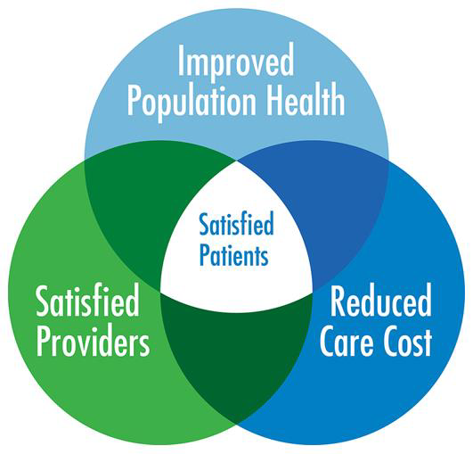
SPOR Focuses on ……..
…….to create LEARNING HEALTH ENVIRONMENTS

Slide 7
SPOR Enterprise in Ontario
HEALTH OUTCOMES and IMPACT ??
Have health outcomes in Ontario changed as a consequence of SPOR?
What health outcomes are most likely to change?
Will SPOR contribute to cheaper, better, faster healthcare?

Slide 8
The SPOR Opportunity
Premise:
Health care practice and systems will only change when patient-articulated needs are recognized, understood and effectively addressed;
Health policy must support effective change in health care practice and systems;
SPOR is a core enabler of timely change to practice and policy for the most complex, chronic conditions.

Slide 9
SPOR - Operational Framework
…….start with a high needs, high cost health problem
POR Phase 1 -
POR researchers establish relations with Patient Partners and create the opportunities for persons (at high risk) to identify their
most urgent challenges
e.g., Seniors living with diabetes and multiple chronic conditions, who are most likely to end up in acute care (heart and kidney failure, foot ulcers), with caregivers identify their health care needs

Slide 10
SPOR - Operational Framework
POR Phase 2 – identify gaps and potential solutions
Persons (at high risk) identify gaps in health care and support services
Health professionals and support service providers identify their needs to fill these gaps
Researchers search for evidence-based best practice solutions
e.g., Seniors living with diabetes and multiple chronic conditions require ongoing needs assessments in their homes to identify customized support services and interventions to improve self-management, prevent complications the need for acute care
Aging Community Health Research Unit – McMaster University

Slide 11
SPOR - Operational Framework
POR Phase 3 – design and conduct intervention
Patient Partners, researchers, health care professionals, community organizations and institutions work together to co-design real-world interventions and iterative evaluation to provide evidence for solutions
e.g., A Client-Driven Intervention to Support Self-Management among Community-Living Older Adults with T2D and Multiple Chronic Conditions
ACHRU – MOHLTC and CIHR pilot and feasibility study (RCT)

Slide 12
Community Partnership Program T2D ≥ 65 yr with more than 2 chronic conditions
Home visits
Monthly Group Sessions
Monthly Nurse-led Case Conferences
Nurse-led Care Coordination
Source: CDC #14167



Source: CDC #13735
Notes:
A complex intervention with several interacting components
Participants were
offered 4 in-home visits
- delivered by RN and RD
invited to take part in 6 monthly group sessions
- light meal
- socializing time
- gentle exercise (* first assessed by a registered kinesiologist)
- interactive and flexible diabetes education and discussion
montly case-conferences
- client-centred
- evidence-based
nurse-led care coordination
- coordinate
- access services
- communication (pt, cg, team & primary care)
Group sessions & home visits:
Promote self-efficacy
Be comprehensive
Be flexible

Slide 13
2017 ACHRU Publication
Community Program Improves Quality of Life and Self- Management in Older Adults with Diabetes Mellitus
and Comorbidity
Markle-Reid M, et al. J of American Geriatrics Society
Sponsor’s (CIHR (IHSPR) + MOHLTC) Role:
The study design used an integrated KT approach which resulted in regular KT events with funding agencies to engage them in the research results and identification of policy implications.

Slide 14
SPOR - Operational Framework
POR Phase 4 - design and evaluate scale-up and spread
Patient Partners, researchers (implementation science), health care professionals (multiple disciplines), health system and policy decision-makers work together to design feasible, timely, cost-effective, scale-up and spread evaluation
e.g., ACHRU Community Partnership Program for Diabetes Self-Management for Older Adults in Canada
SPOR supported:
BeACCoN -> PIHCIN programmatic grant (Diabetes Action Canada match)
Ontario (Toronto), Quebec, Alberta, PEI (many SPOR Collaborators)
Ontario Knowledge Users: Patrick Dicerni, Phil Graham

Slide 15
SPOR – Success Factors and Challenges
Collaborative and Consistent Engagement of:
Patient Partners (including caregivers)
Health professionals and communities of practice
Health system and policy decision-makers
Sustained funding from multiple stakeholders
……. with SPOR investigators

Slide 16
The SPOR Opportunity in Ontario
All the SPOR elements and stakeholders
working together:
SPOR SUPPORT Unit - Infrastructure and support
SPOR Networks, iCTs, Evidence Alliance, Data Platform
Health system and policy decision-makers
Government, agencies and health care institutions
Sponsoring stakeholders (CIHR, NGOs, private sector)
…….to achieve COLLECTIVE IMPACT

