Slide 1

Understanding the Collective Impact of
SPOR in Ontario
Workshop
Women’s College Hospital
January 21, 2019

Slide 2
Agenda
Time | Topic
9:00 – 9:05 | Welcome – Marilyn Emery
9:00 – 9:15 | Introductions and Objectives for the Day - Geoff Anderson
9:15 – 9:30 | The SPOR Enterprise in Ontario: Overview, opportunities and challenges - Catharine Whiteside
9:30 – 9:45 | Collective impact framework applied to SPOR: Focus on Common Agenda and Metrics - Onil Bhattacharyya
9:45 – 10:00 | Discussion – All
10:00 – 10:45 | Reports and Discussion on Activities and Agendas of Each SPOR Element in Ontario - All
10:45 – 11:00 | Break
11:00 – 11:15 | Evaluation and SPOR – Vasanthi Srinivasan and Eddy Nason
11:15 – 11:45 | Reports and Discussion on Evaluation Plans and Metrics of Each SPOR Element in Ontario - All
11:45 – 12:00 | Summary and Next Steps – Geoff Anderson
12:00 – 1:00 | Networking Lunch

Slide 3

Research Evaluation and SPOR in Ontario
January 21st 2019
Eddy Nason
Assistant Director, Ontario SPOR SUPPORT Unit

Slide 4
To cover
What is evaluating research?
What’s the trend in this work?
What’s evaluation in SPOR all about?
What do we need to do to understand impact / ROI in Ontario for SPOR?

Slide 5

Research evaluation – research on research
Evaluating research can be considered to be for one or more of four reasons (4A’s)
Two key issues to address:
  Capturing impacts as they fan out from research
  Categorizing impacts
INPUT
…
…
PROCESS
…
…
OUTPUT
…
…

Slide 6

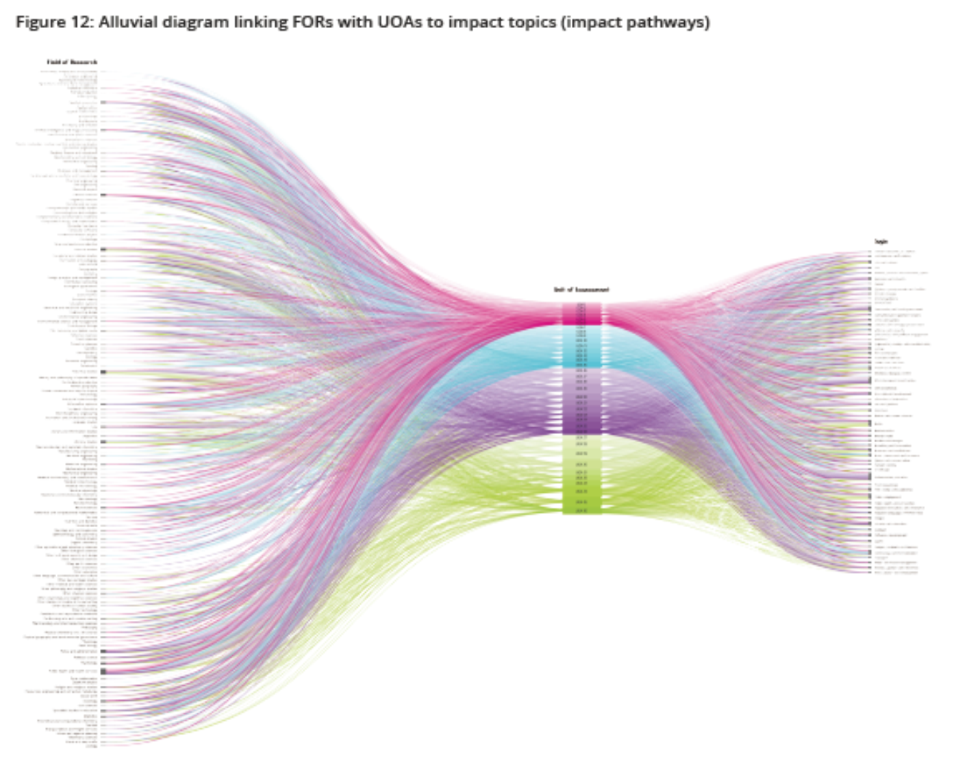



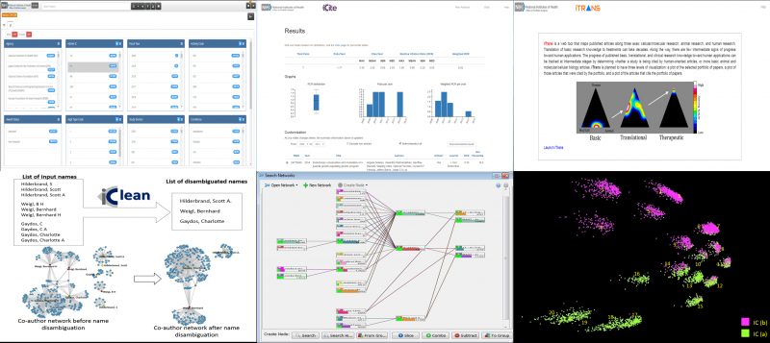
The state of the art

Slide 7
Narratives vs. metrics
Narratives
Impact narratives allow large amounts of complex impact information to be collated and stated
Impact narratives require organization and thought
There are processes to go through to build impact narratives
There are templates and guidance available to you
Impact narrative analysis can be tough but worthwhile
Metrics
Impact metrics provide easily comparable year-on-year data
Metrics can be subject to both statistical analysis and targets
Common metrics can be easily compared across evaluations
Metrics tend to be reductive and miss impacts
Metrics are subject to misinterpretation and gaming
Metrics drive behaviour (often in unexpected ways)

Slide 8
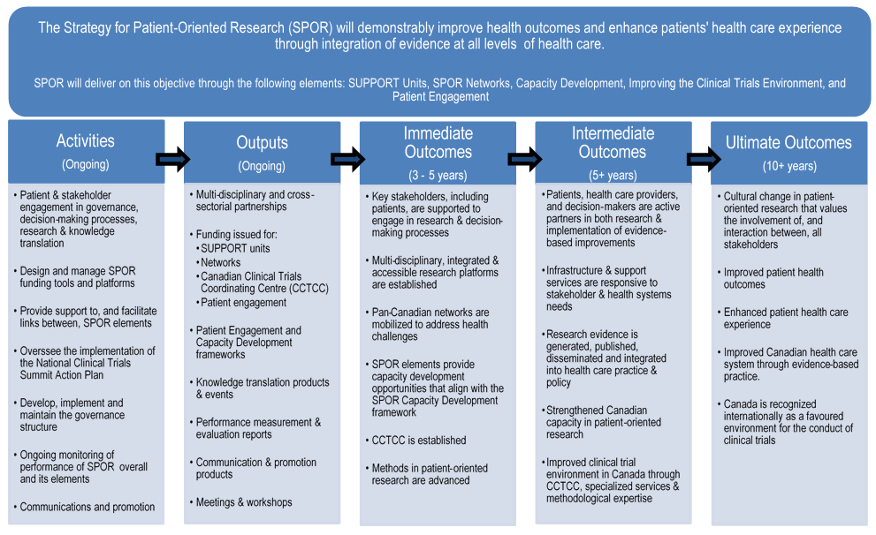
Evaluation in SPOR

Slide 9
Evaluation in SPOR
Impact conversation has switched since the 5-year SPOR evaluation to one that focuses on:
Collective impact
Stronger focus on ultimate outcomes
Acceptance of the challenge of metric-based approaches
Attempt to clarify evaluation vs. performance measurement

Slide 10




Understanding impact / ROI of SPOR in Ontario

Slide 11
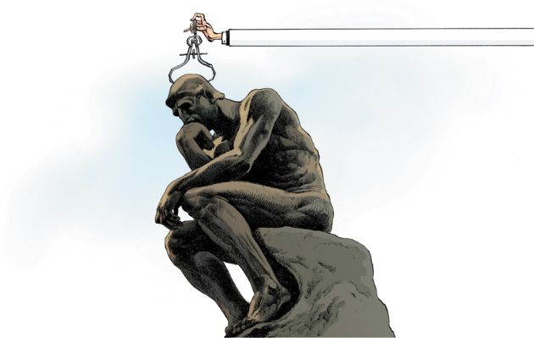
For more information:
Contact:
Eddynason@ossu.ca
Further reading
Metrics: “The Leiden Manifesto for Research Metrics”
http://www.leidenmanifesto.org/
ROI: “Medial Research: What’s it Worth?”
https://www.rand.org/pubs/external_publications/EP20080010.html
Narratives: Writing impact narratives
http://www.mayaproject.org/blog/2015/10/16/how-to-write-a-winning-research-impact-case-study

