Slide 1
Understanding the Collective Impact of SPOR in Ontario
Workshop
Women’s College Hospital
January 21, 2019

Slide 2
Agenda
Time | Topic
9:00 – 9:05 | Welcome – Marilyn Emery
9:00 – 9:15 | Introductions and Objectives for the Day - Geoff Anderson
9:15 – 9:30 | The SPOR Enterprise in Ontario: Overview, opportunities and challenges - Catharine Whiteside
9:30 – 9:45 | Collective impact framework applied to SPOR: Focus on Common Agenda and Metrics - Onil Bhattacharyya
9:45 – 10:00 | Discussion – All
10:00 – 10:45 | Reports and Discussion on Activities and Agendas of Each SPOR Element in Ontario - All
10:45 – 11:00 | Break
11:00 – 11:15 | Evaluation and SPOR – Vasanthi Srinivasan and Eddy Nason
11:15 – 11:45 | Reports and Discussion on Evaluation Plans and Metrics of Each SPOR Element in Ontario - All
11:45 – 12:00 | Summary and Next Steps – Geoff Anderson
12:00 – 1:00 | Networking Lunch

Slide 3
Collective Impact Framework Applied to SPOR: Focus on Common Agenda and Metrics
Onil Bhattacharyya
Frigon Blau Chair in Family Medicine Research
Clinical lead for Ontario, BeACCON
National Co-Chair, Primary and Integrated Health Care Innovation Network

Slide 4
From Isolated to Collective Impact
Isolated Impact
Funders select individual grantees
Groups work separately
Evaluate to isolate a particular group’s impact
Make large scale change by scaling organizations or projects
Communities and government loosely or disconnected.
Collective Impact
Funders understand that social problems – and solutions – arise from multiple interacting factors
Cross-sector alignment with government and community sectors as partners
Organizations actively coordinate their actions and share lessons learned
All work toward the same goal and measure the same things

Slide 5
The Collaboration Spectrum
Trust
Compete | Co-exist | Communicate | Cooperate | Coordinate | Collaborate | Integrate
Competition for clients, resources, partners, publicity. | No systematic connection between groups. | Some information sharing | As needed, often informal, interaction, on discrete activities or projects. | Groups adjust and align work with each other for greater outcomes. | Longer term interaction based on shared mission, goals; shared decision-makers and resources. | Fully integrated programs, planning, funding.
Turf
Loose
Tight

Slide 6
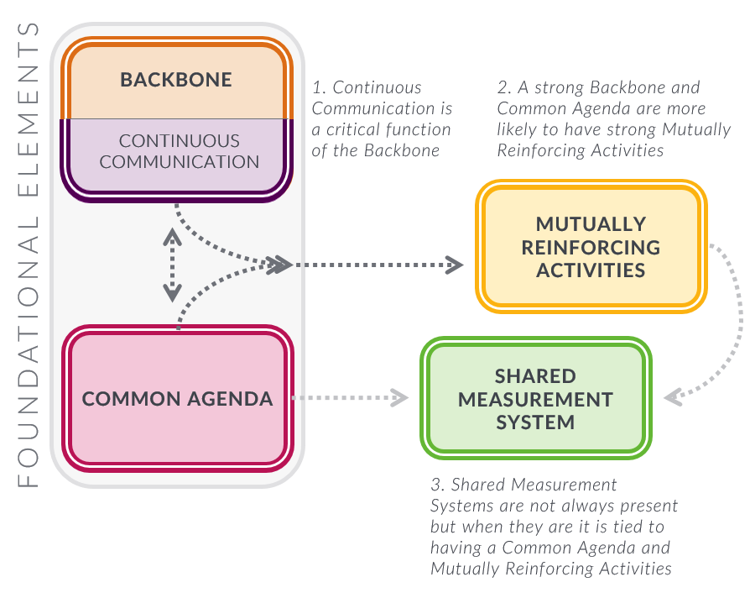
Achieving Collective Impact
Stawochiak & Gase, 2018

Slide 7
Components of a Common Agenda
Principles
Common Problem Definition
Goal
Framework for Change
Plan for Learning
Notes:
Principles
Agreed upon values that guide the group in laying out the rest of the common agenda, making decisions, and how the group is going to work together overall.
Common Problem Definition
A common understanding of the problem the group is trying to solve. Often this involves establishing boundaries for what issues, players, and systems the group will in engage with, and which are outside its scope. The problem definition is built on a shared understanding of the root causes of the issue at hand.
Goal
A measurable, population level goal that demonstrates how you will define success.
Framework for Change
A structure for how the group will split up the work (into working groups, backbone roles, policy groups, etc.) and prioritize limited resources.
Plan for Learning
A plan for how you intend to track your progress and learn from your efforts as an initiative.

Slide 8
Example: Unidos Contra Diabetes guiding principles
Serve the whole community through a systems oriented approach
2. Take an asset-based approach
3. This is everyone’s responsibility
4. Think holistically about health
5. Empower people and families
Notes:
1. Serve the whole community through a systems oriented approach We support not only the individuals at risk for diabetes, but also their families and the communities they live in. We strive to change the overall system, including policies, practices and culture and norms to create a healthier community
2. Take an asset-based approach
We will view all families and individuals as assets to build upon and avoid shaming people for poor health
3. This is everyone’s responsibility
Diabetes prevention is a shared responsibility of the entire community, including the private sector, governments, schools, families, and individuals at risk for diabetes
4. Think holistically about health
We believe that supporting health means promoting mind, body, and spiritual wellness
5. Empower people and families
We commit to empowering individuals and families with the knowledge and cost- effective care and tools they need to take their health into their own hands

Slide 9
Defining The Problem
Set boundaries
Use quality data to inform thinking
Allow it to change over time

Slide 10
Setting a Goal
Choose a goal that can be measured
Make it audacious and inspiring
Consider equity
Setting a Goal

Slide 11
Framework for Change
Structure how the group will split up the work
Working groups, policy group, roles
Determine how to prioritize limited resources
Setting a Goal

Slide 12
Planning for Learning and Evaluation
Incorporate early thoughts on shared measures
Note change on different scales
Strongly emphasize learning

Slide 13
Thinking About Shared Measurement
Shared Measurement
Process: # of people/orgs at table, # of community presentations, articles, etc
Progress: # of programs, # of new initiatives, etc
Policy: policy changes in own or other organizations, new investments, gov. policy changes
Population : # of people moved out of poverty, # of high school graduates, # of low birth weight babies

Slide 14
Collective Impact on the ground- SPOR as a catalyst
Collective Impact Factor | Case study for chronic disease management (Diabetes and complex needs)
1. Common agenda | MoU with Toronto Central regional authority joining up to align agenda around population-health planning for people with diabetes and complex needs (DAC/PICHIN projects)
2. Shared Measurement System | Leveraging data assets and analytical capacity from IC/ES via OSSU partnership
3. Mutually reinforcing activities | Co-designed interventions from researchers, targeting key populations in sub-regions (Diabetes interventions)
4. Continuous Communication | Regular working groups formed to facilitate evidence-sharing and data for monitoring and planning
5. Backbone Organization | Testing the feasibility of an on-going platform (data, resources, strategy) to support alignment on the ground

