Slide 1
Patient-Generated Data 2.0
Informing an Approach for Ontario Workshop
April 15, 2019
Women’s College Hospital
Patient Advisors Network
www.beaccon.ca
@BeACCoN_SPOR

Slide 2
Agenda
9:00am Welcome and Why this Matters
9:15am Overview of Patient-Generated Data
9:45am Show and Tell
10:30am Draft Principles and Discussion
10:45am Break
11:00am Draft Standards
11:30pm Group Discussion: Standards and Governance
12:00pm Opportunities for Moving Forward
12:15 Networking Lunch

Slide 3
Objectives for the day
Exploring models of patient-generated data that could inform an approach in Ontario
Looking at the current state of patient-generated data in greater detail
  Types of patient-generated data collected, how it’s being collected, and for what purpose
  Benefits, opportunities, and challenges of PGD use
  Governance structures
  How patients are engaged in the process
Discussing a draft framework and principles for patient generated data

Slide 4
Welcome to the PGD 2.0 Workshop
Why this matters
Alies Maybee
In consultation with Samira Chandani

Slide 5
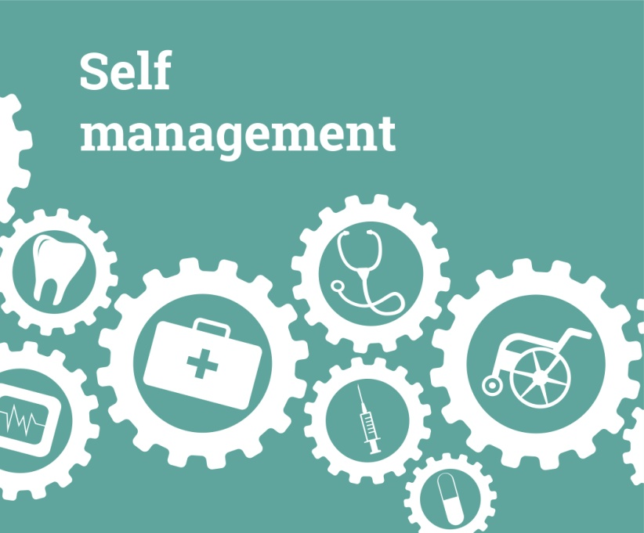


Why this matters to citizens - opportunities
Shared decision-making

Slide 6

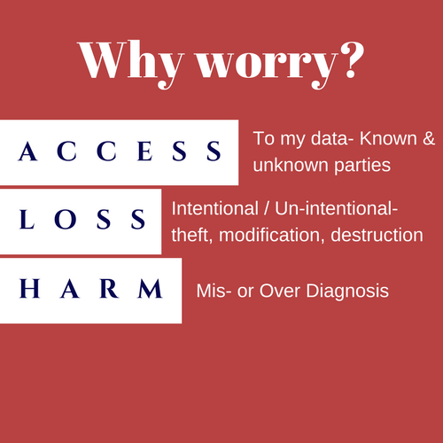
Why this matters to citizens - concerns

Slide 7
Context
  BeACCoN held its first workshop on patient-generated data at Women’s College Hospital on September 10, 2018
  Discussed the principles, priorities, and challenges
  faced by important stakeholders
  Goal was to begin mapping them for the
  patient-generated data initiative in Ontario
      Attended by:
      patients
      policymakers researchers developers

Slide 8

Priorities
Common priorities among the stakeholders included:
    Streamlining access to data
    Data linkages -- integration
    Creation of standards
    Update privacy and ethics regulations – modernize
    Develop value models – support private sector innovation

Slide 9

Challenges
Some challenges noted by the stakeholders included:
  Consent
  Governance
  Awareness
  Partnering with patients
  Real-time data
  Costs

Slide 10
Overview of Patient Generated Data
Onil Bhattacharyya
Frigon Blau Chair in Family Medicine Research
Women’s College Hospital
Clinical Lead, BeACCON
National Co-Chair, Primary and Integrated Health Care Innovation Network

Slide 11
Overview
What is patient-generated data?
What do patients want?
What tools are out there?
How are they used?
Where could this go?

Slide 12
What is patient-generated data?
“health-related data created, recorded, or gathered by or from patients (or family members or other caregivers) to help address a health concern”
US Office of the National Coordinator for Health Information Technology
Notes:
Working definition began in 2012.

Slide 13
What is patient-generated data?
Is it defined by
Type of data?
Means of collection?
Who handles it?
Where it is stored?

Slide 14
What do patients want?

Slide 15
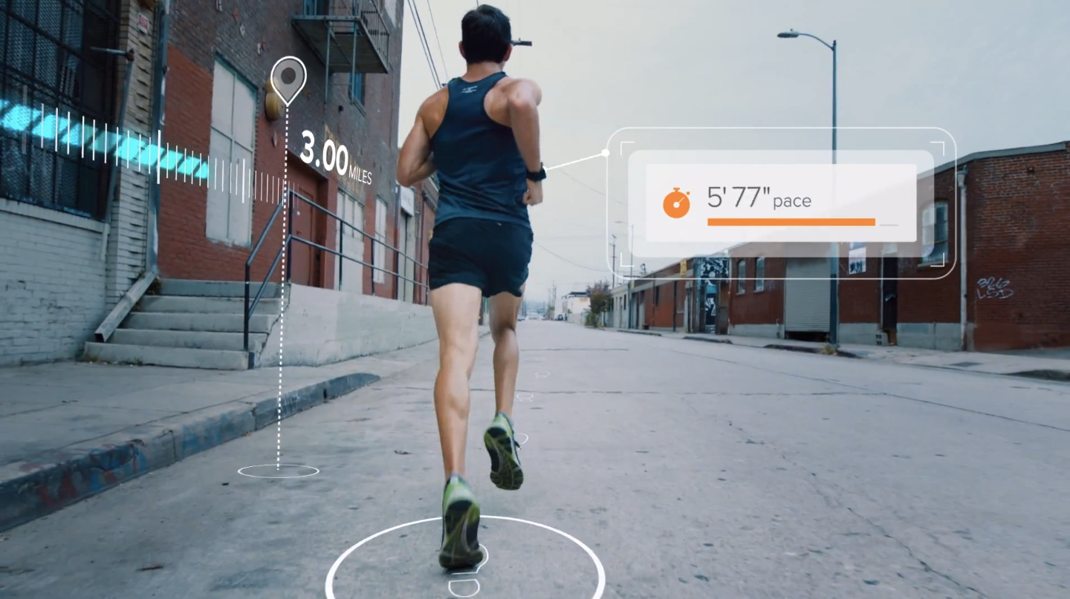

Slide 16
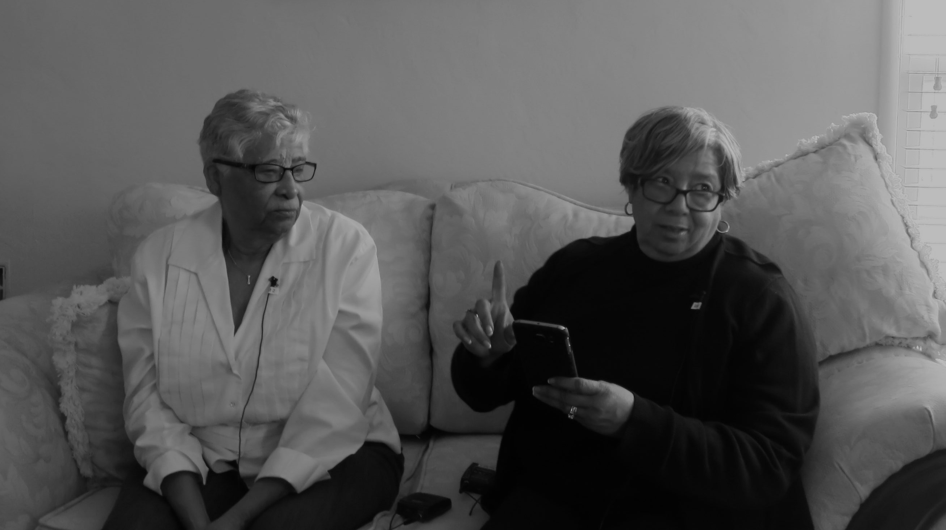
Designing for people with complex needs could help everybody
Notes:
multiple medical and social needs
fragmented care
difficulty navigating everyday life
stress, loneliness, and emotional trauma

Slide 17
Patient and caregiver needs
functional NEEDS
Live My Life
Manage My Health
PERSONAL
MEDICAL
Love My Life
Feel Understood
emotional NEEDS

Slide 18

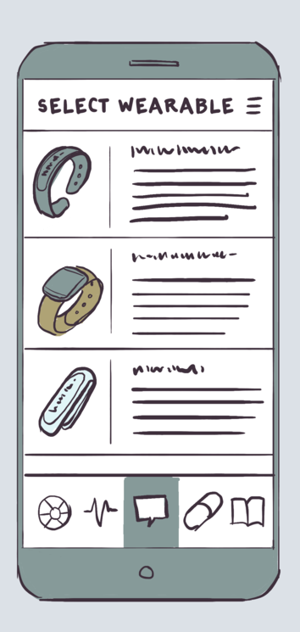
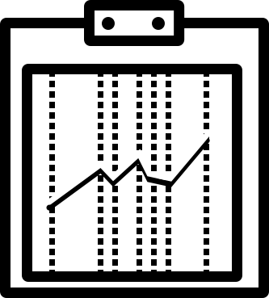
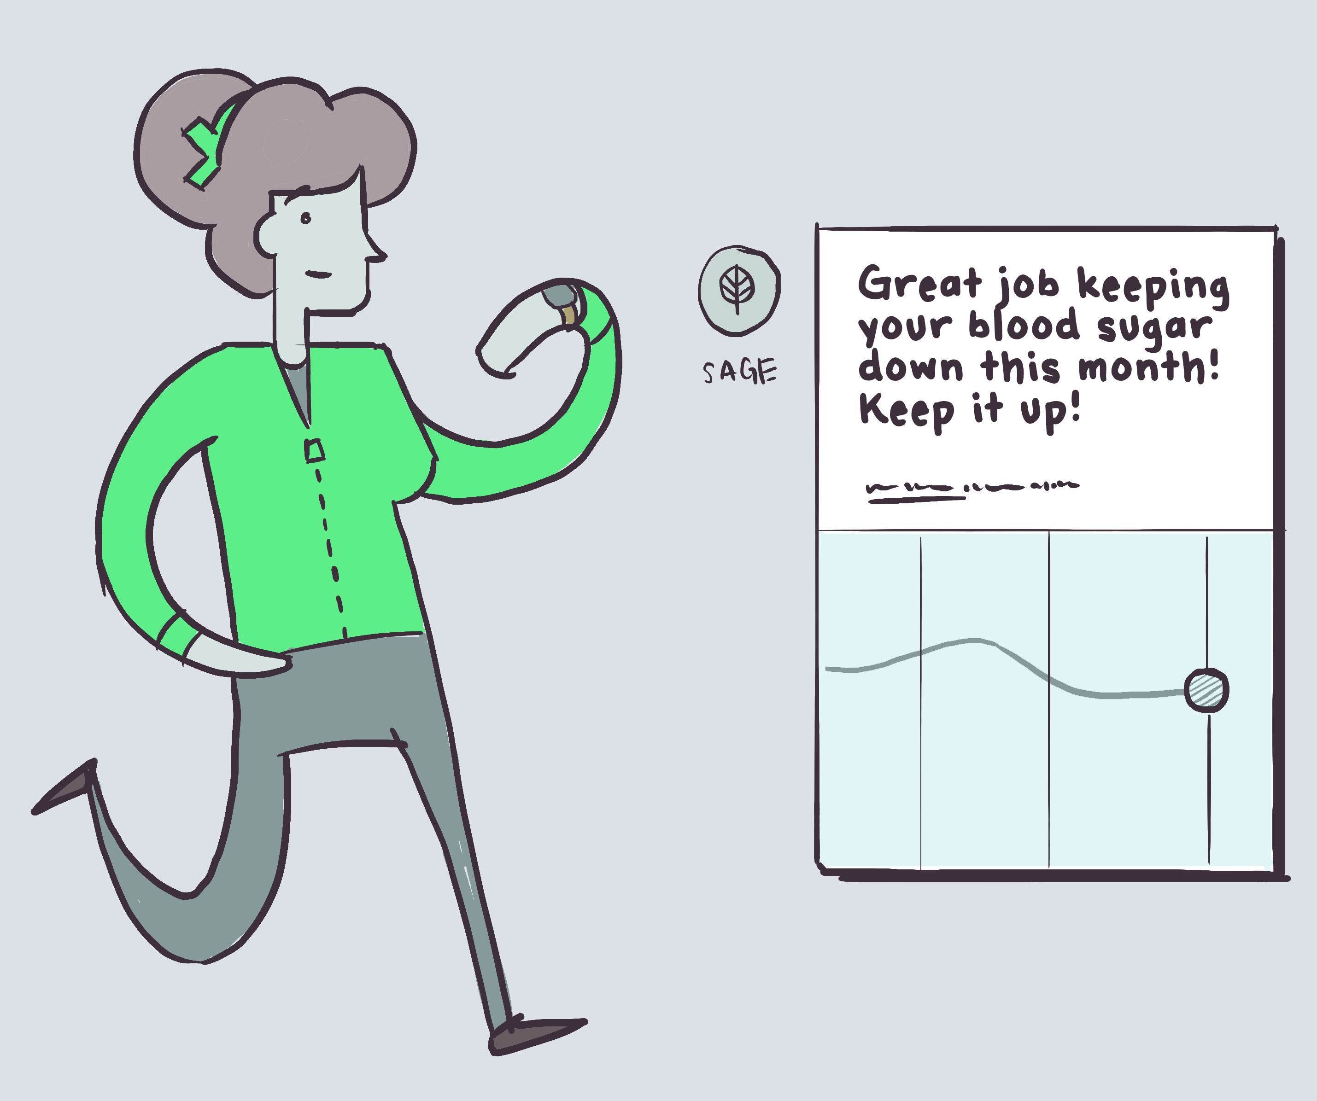


Key functions
Advice & Information
Tracking & Insights
Holistic Picture
Coordination & Communication
Notes:
Tracking health indicators with a metric dashboard that collects data from apps and wearables, providing simple recommendations to help patients take action to make healthy decisions
Also important for caregivers who aren’t always with the patient

Slide 19
What tools are out there?

Slide 20
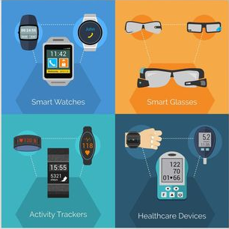
Wearables
Notes:
Wearable technology makes use of sensors (physiological, biochemical, and motion) to produce produce data that can aid in the diagnosis, management, monitoring and analysis of diseases.
The data that is collected could also be shared with caregivers.
Wearables are unobtrusive, easy to use, and do not interfere with your everyday life.
Examples of wearables include health trackers such as FitBit and Jawbone. They also include mobile watches such as Samsung Gear or Apple Watch.

Slide 21
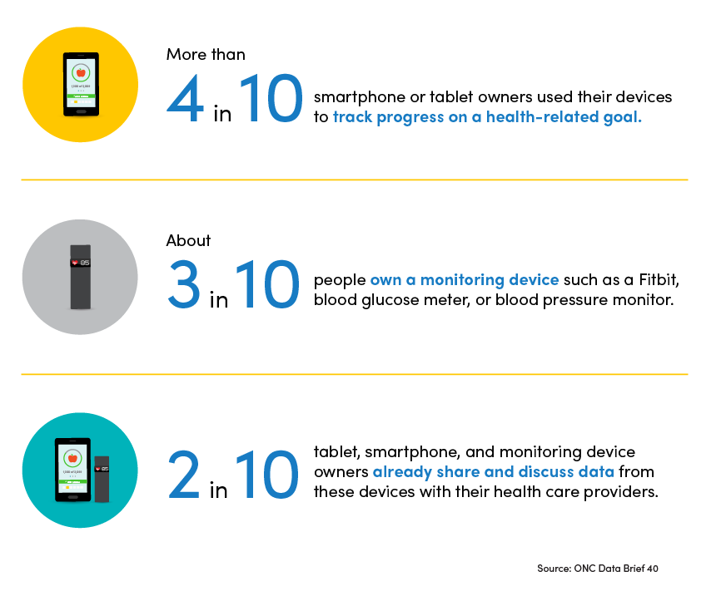
Monitoring devices and Apps
Notes:
Visual from ONC’s The Patient Engagement Playbook, January 2019
Used by individuals to monitor their health at home
Used intermittently, not on a continuous basis (unlike wearables)
Results can be recorded manually
Results could be communicated to others electronically, via bluetooth technology
Common examples: blood pressure monitors, glucometers, inhalers and oximeters

Slide 22
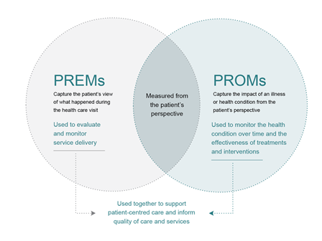
PREMs/PROMs
Notes:
PROMs have been used widely and internationally for the purposes of health policy, population health monitoring, and health care administration.
Several countries collect information on PROMs including the US, the UK, the Netherlands, Sweden, and New Zealand.

Slide 23
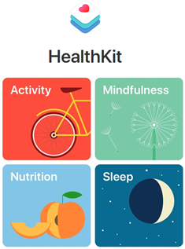
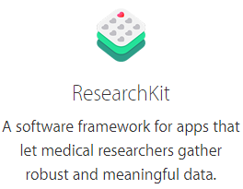
Interaction with EMRs
2014
2015
Notes:
In 2014, Apple launched HealthKit, to be used as a common framework amongst developers in order to share PGD amongst apps, services and providers.
Afterwards, ResearchKit was launched in 2015, to act as an open framework to give investigators the infrastructure to develop mobile applications.
The purpose was to create these apps for research purposes via mobile phones.

Slide 24
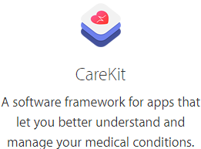
Interaction with EMRs
2016
Notes:
In 2016, Apple announced CareKit, which is a software framework that is designed to help developers enable people to actively manage their own medical conditions. CareKit makes it easier for individuals to keep track of care plans and monitor symptoms and medication. This information could be shared doctors, nurses or family members.

Slide 25
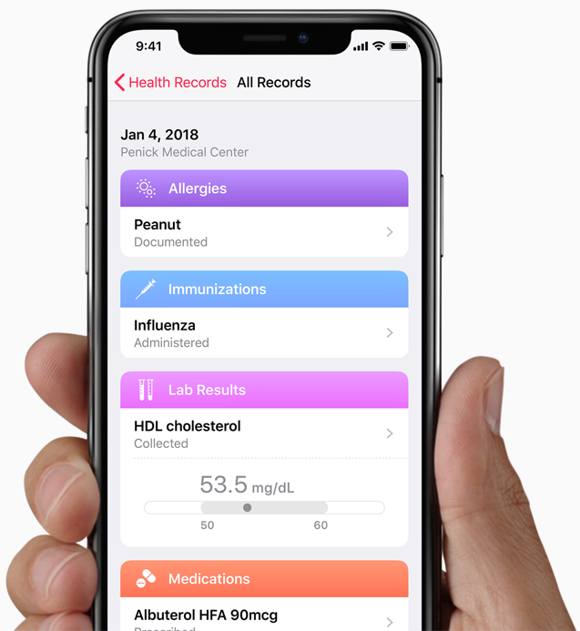
Interaction with EMRs
2018
Apple Health Records
Notes:
Health Records allows individuals to see their medical records on their iPhone.
Able to view available medical data from multiple providers whenever they want.

Slide 26
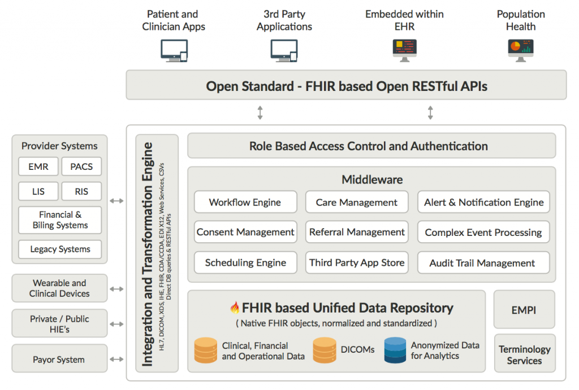
Integration with EMRs

Slide 27
How are they used?

Slide 28
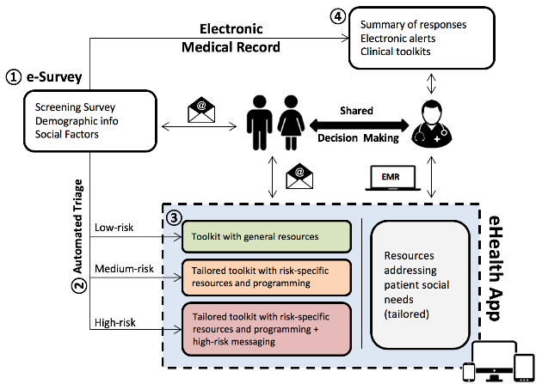
Self-management Support

Slide 29
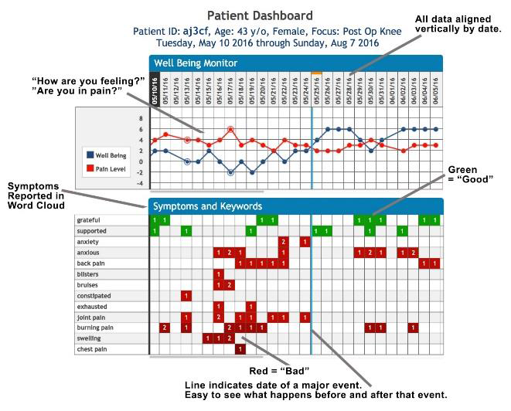

Clinical Decision Support
Notes:
Visual: Tapcloud’s Patient-facing module for collection of PGHD
TapCloud is a platform that connects patients and clinicians outside the clinical setting. Tapcloud focuses on data about how the patient is feeling, rather than data such as number of steps or blood pressure. Their platform consists of two parts:
The patient app provides information to and collects information from patients.
The clinical dashboard synthesizes the large volume of data and converts them into an easy-to-use visualization.
TapCloud’s platform provides care plans, reminders, and critical health information to patients.
TapCloud works for more than 90 medical conditions and is also available in and could be interchanged in multiple languages. For example, the patient can enter their information in Spanish and the doctor could receive the data in English.

Slide 30
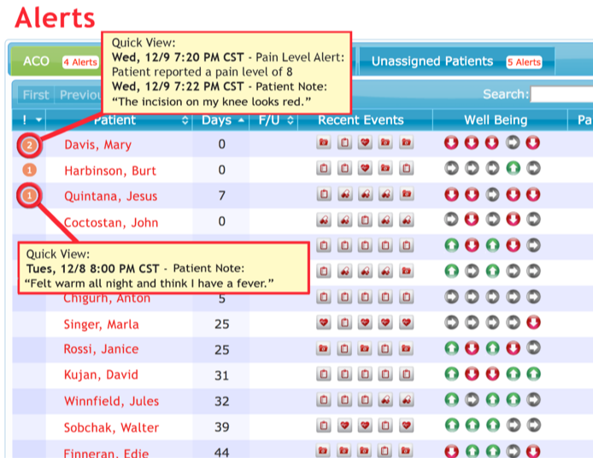

Clinical Decision Support
Notes:
Tap Clouds’s Physician facing module for analyzing PGHD

Slide 31
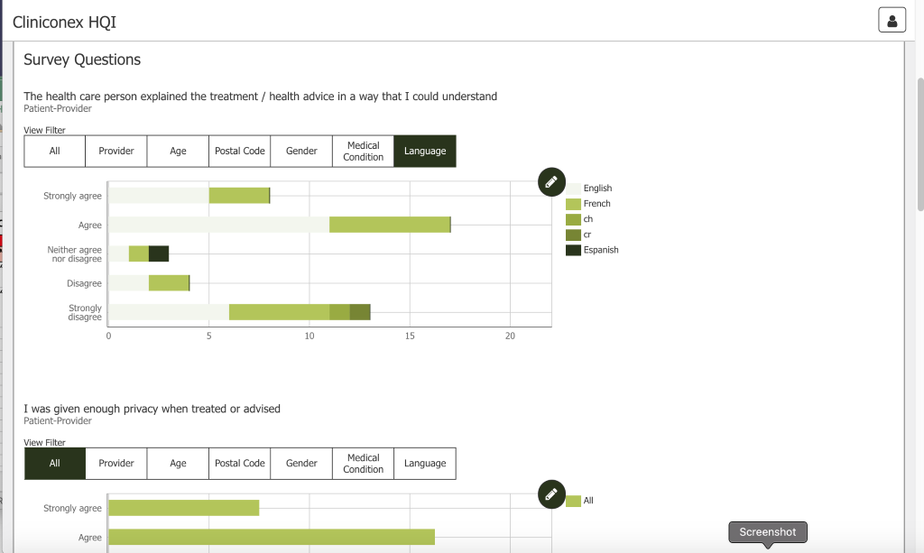
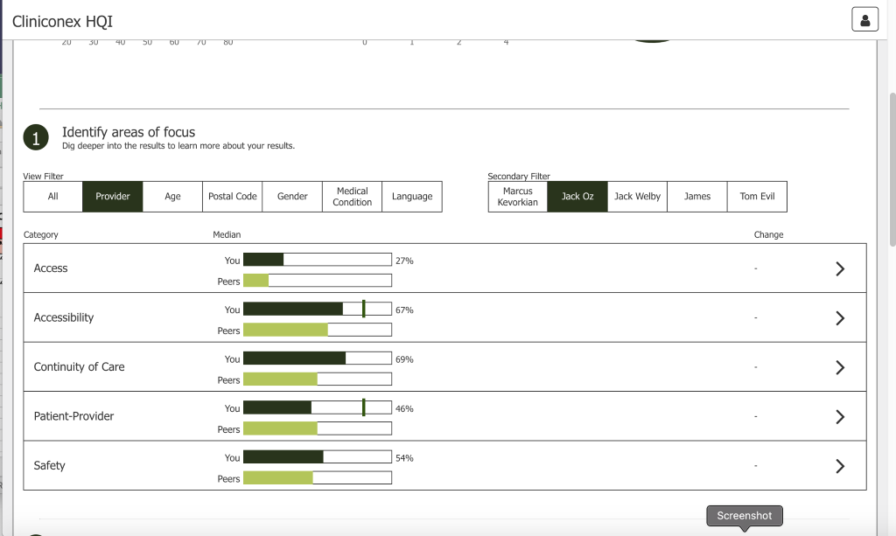
Quality Improvement
Canadian Practice Information Network
Notes:
Visual

Slide 32
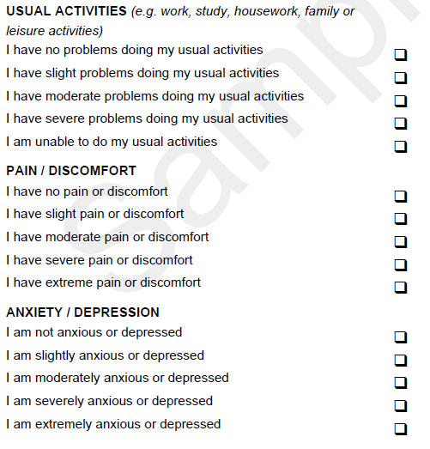
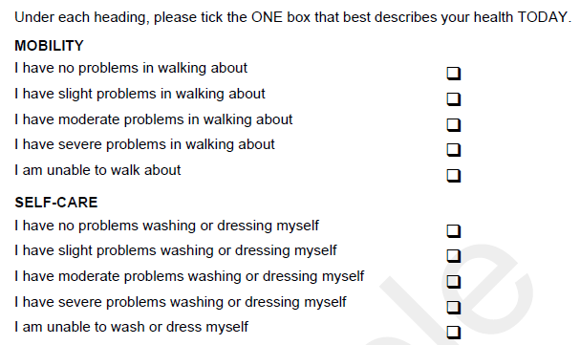
Performance Reporting
Notes:
Visual for NHS post-surgical survey (Sample from the EQ5D)

Slide 33
Performance Reporting
Notes:
Visual for CMWF survey table

Slide 34


Research
Notes:
Mpower is a Sutter Health-developed system for personalized care that targets large-scale populations and supports health maintenance and disease management.

Slide 35
Where could this go?

Slide 36
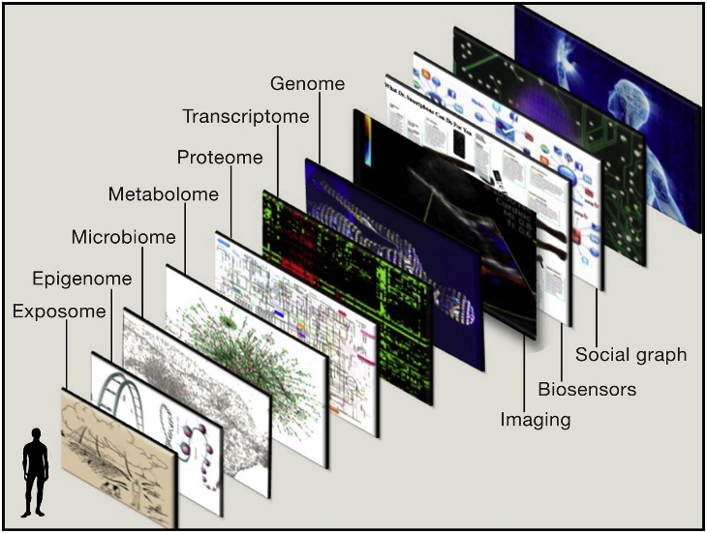
More data
Topol, Cell, 2014

Slide 37
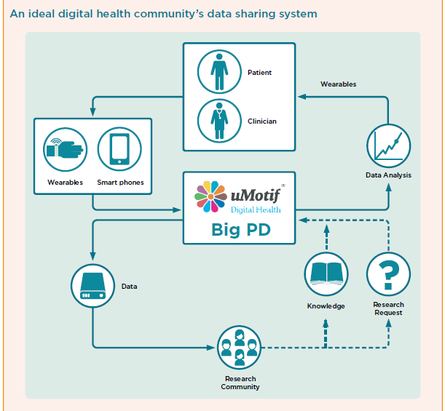
Better Linkages
NHS in 2030, Nesta, 2015

Slide 38
Patient-centered Information Systems
Public Data Assets
Private Data Assets
National Health Statistics
New Intermediaries
Medical Services
Social Services
Patientslikeme, Health Bank, 23&me
Personal Data Assets
Digital Social Activity
Genetic Data
Data from Apps and Wearables
  Adapted from NHS in 2030 Nesta, 2015

Slide 39
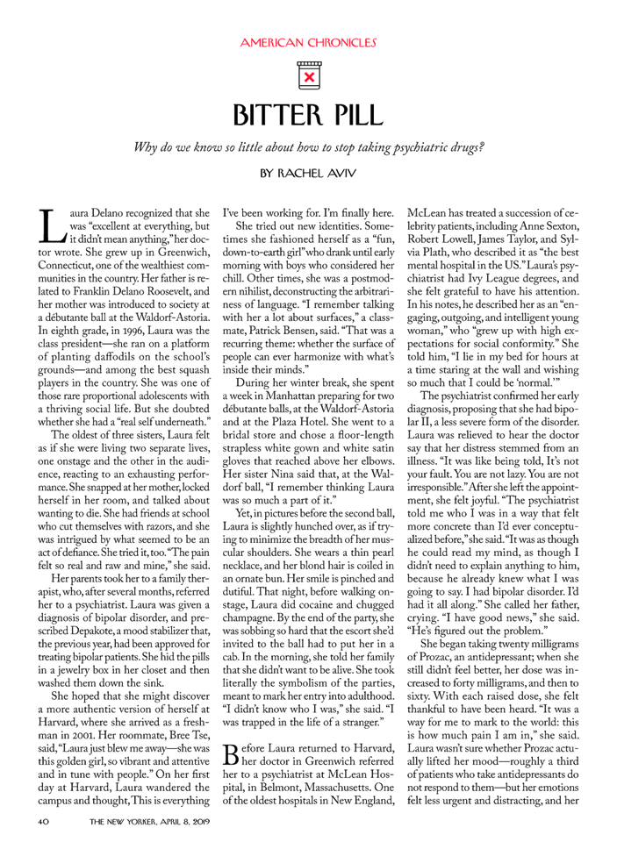
Patient-Driven Research
New Yorker, 2019

Slide 40
Group Discussion

Slide 41
Show and Tell
Website: beaccon.ca
Twitter: @beaccon_SPOR

Slide 42
Bridgepoint Collaboratory
for Research and Innovation
Carolyn Steele Gray
Website: beaccon.ca
Twitter: @beaccon_SPOR

Slide 43
What kinds of patient-generated data do you collect?
☑ Patient reported experience measures (PREMs)
☑ Patient Reported Outcome Measures (PROMs)
☑ Demographics
☐ Health History
☐ Biometric Data
☑ Lifestyle Choices
☑ Other
Please specify: Goal Attainment
How?
Surveys
Mobile apps
Interviews
Observations
Why?
Enabling person-centred delivery of primary care services for patients with complex care needs living in the community.
Supports patient empowerment as well as managing health and social care needs.
Currently in pragmatic trial.

Slide 44
What have been the benefits of using PGD?
Using PGD to understand the impact of our technology in primary care
Can uncover what is important and meaningful to patients, particularly with regard to identifying goals of care
  Enables building strong relationships and improved communication between providers and patients
What other potential opportunities exist?
Enabling inter-professional person-centred care delivery within and between organizations
Supporting clinical decision-making in the context of what is important to patients and their families

Slide 45
What barriers and challenges have you run into?
Site and patient recruitment
Provider engagement
Fitting research into real-world practice contexts
Timeliness of responses to surveys
Addressing data security and privacy concerns from multiple organizations and stakeholders
Overcoming data overload for our providers
What changes would you like to see?
Support for research and innovation culture in primary care (starting at the level of training)
New funding models and provider roles that enable research and innovation
Establishing smoother processes for ethics and data sharing agreements

Slide 46
Governance
As a research project we are under the umbrella of different applicable governance structures (applicable REBs, and governance bodies at our research and trial sites)
The project itself is driven by an interdisciplinary team which includes a patient representative and provides oversight to the project
Framework
If a guideline, framework, or set of principles for PGD were created, what kinds of information would you hope to find?
  Ensuring tools are person-centred not just person-generated (required attention to development and validation)
  Guidelines for both clinical and research applications of PGD
  Guidelines for modification of tools to meet local contexts (how do we adapt and remain rigorous?)

Slide 47
Patient Engagement
ePRO has been co-designed with patients, caregivers and providers
We have always had a patients and/or caregivers as part of the research team
ePRO Exchange – monthly newsletter to all participants about the project
  Includes articles written by patients
Briefly describe what works and what doesn’t for patient engagement
Engage early without predetermined ideas of what you hope to get out of that engagement – let them lead
Prepare patients and families for meetings or co-design sessions – using “pre-briefs”
Create open communication lines and safe spaces so concerns and ideas can be shared back to the research team
  Single point of contact
  Dedicated email and/or phone line

Slide 48
ACHRU, McMaster University
Kathryn Fisher
Website: beaccon.ca
Twitter: @beaccon_SPOR

Slide 49
What kinds of patient-generated data do you collect?
☑ Patient reported experience measures (PREMs)
☑ Patient Reported Outcome Measures (PROMs)
☑ Demographics
☐ Health History
☑ Biometric Data
☑ Lifestyle Choices
☑ Other
Please specify: Health and social service use/costs
How?
Interviewer-administered surveys
Qualitative telephone interviews
Interviewer-administered surveys and ICES data on service use
Why?
+ Improving chronic disease management
+ Enhancing patient self-management
+ Enhancing patients involvement in their health care
+Improving caregiver quality of life & supports
+ integrating health care services
+ Determining health and social service use/cost impacts of interventions

Slide 50
What have been the benefits of using PGD?
Timely access to information
Availability of information (e.g., HRQoL & other PROMs not captured elsewhere, experience)
Accuracy and depth of information (e.g., probe patients to better capture interpretive issues, sensitivities etc.)
What other potential opportunities exist?
Capturing mental health outcomes (typically under-reported in administrative data), SDOH and social service use (not available from administrative data)
Gaining new knowledge from patients and their caregivers to inform intervention design & implementation

Slide 51
What barriers and challenges have you run into?
Privacy & ethics issues, e.g., data sharing agreements
Key data missing in admin. databases (e.g., SDOH, HRQoL)
Timely and cost-efficient access to admin. data
Costs, burden and feasibility of collecting data directly from patients and caregivers (e.g., cognitive impairment/proxies)
Translation and cultural sensitivity of survey tools
Data integration from different sources (e.g., ICES data, patient surveys, EMRs, municipal data)
Data reconciliation across different sources
Data harmonization and analyses across sites and provinces
What changes would you like to see?
Better integration of data across different sources (e.g., technical issues, ethics support)
Higher priority assigned by policy makers to PROMs and PREMs

Slide 52
Governance
A governance structure exists in many of our studies, often includes:
  Steering Committee (overall study oversight, includes research team, policy makers, provider groups, patients/caregivers)
  Community Advisory Boards (local site issues, includes research team, local policy makers/providers, local patients/caregivers )
  Patient Advisory Councils (independent patient/caregiver input)
Patients/caregivers included on all Committees/Councils & provided independence through Patient Advisory Councils
Sample attached (at end)
Framework
Key Principles:
  Confidentiality
  Informed Consent
  Patient/Caregiver Engagement in Health Care and Research
  Health Equity (broad cross-section of population/communities)
  PRECIS criteria (pragmatic RCT designs)
  Patient-centred approach (intervention design, research)

Slide 53
Patient Engagement
Patients/caregivers inform interventions and research methods via membership on Community Advisory Boards (CABs) & Patient Advisory Councils (PACs)
Regular meetings with CABs and PACs to inform patients/caregivers and obtain their input
Partnering with patients/caregivers to develop KT outputs (e.g., research briefs, videos, conference presentations, scientific publications)
Briefly describe what works and what doesn’t for patient engagement
  Lay language in meetings & documents
  Tailoring/aligning involvement with skills/interests
  Reimbursement for study involvement (e.g., time, travel)
  Proactive response to patient/caregiver constraints (e.g., choice of meeting times/locations, patient/caregiver obligations, health care challenges, supports to recruit & retain patients representing vulnerable groups)
  Team commitment to patient engagement

Slide 54
Canadian Institute for Health Information (CIHI)
Greg Webster
Website: beaccon.ca
Twitter: @beaccon_SPOR

Slide 55
What kinds of patient-generated data do you collect?
☑ Patient reported experience measures (PREMs)
☑ Patient Reported Outcome Measures (PROMs)
☑ Demographics
☑ Health History
☐ Biometric Data
☐ Lifestyle Choices
☐ Other
Please specify: _____
Why?
CIHI provides comparable and actionable data and information that are used to accelerate improvements in health care, health system performance and population health across Canada.
Data collected from the patient’s perspective has been a missing gap, as traditionally we have used clinical and administrative data sources.
How?
CIHI is a secondary data collector. Data submitted electronically by health system players, with or without a commercial vendor.
Modes of collection from patients vary: paper (mail), telephone, tablet, website (email).

Slide 56
What have been the benefits of using PGD?
Improve patient-centred and value-based care delivery
Inform performance improvements over time
Drive quality improvement initiatives
Support benchmarking across Canada
Inform clinical and health system decision making
Note: The above are objectives of the programs. PGD data collection and reporting are fairly recent
What other potential opportunities exist?
Growing uptake of acute care PREMs across Canada (over 270,000 records with 5 jurisdictions submitted + 2 in onboarding)
Hip and knee PROMs of interest in several jurisdictions in Canada and OECD (Canada has leadership role internationally)
CIHI’s PREMs/PROMs holdings can be linked to other CIHI data sources to inform patient-centred and value-based care analyses
CIHI will be exploring future areas of expansion for PROMs and PREMs in preparation for next strategic plan (2021 and beyond)

Slide 57
What barriers and challenges have you run into?
Decision to participate is at the jurisdiction/regional level; provincial leadership and mandate (ideally) are key to success
Limited resources/budgets for new data collection (and support for patients)
For PREMs, there is interest in real-time surveying as well as the post-discharge surveying (competing priorities for resources)
Ensuring full adherence to survey standards at national level to ensure comparability of results
Electronic mode of capture is the gold-standard, but some logistic challenges around capture of email addresses as well as high up-front costs for software/hardware infrastructure.
What changes would you like to see?
Continued uptake of national standards and data submission to CIHI for comparative reporting
Innovative solutions to support more cost-effective and sustainable data collection from patients
Dual use of the data collected in terms of use to support point of care (real-time or near real-time) in addition to health system performance monitoring and improvement

Slide 58
Governance
CIHI is a prescribed entity and CIHI’s databases are governed by policies and standard processes for the collection, management, reporting and access of the data
Examples: CIHI has a data quality framework and publishes assessments for each of its databases; privacy impact assessments; standard 3rd party data access program
Framework
Leveraging existing frameworks to extent possible to have a common national framework for PGD
Suggest principles to include building in the re-purposing of data (i.e. not just for clinical care but for health system reporting uses). Broadened purposes may also remove the need for separate patient consent processes, which can be limiting.
Guidelines around the use of technology and privacy aspects in terms of collection and sharing with other parties (e.g. CIHI)

Slide 59
Patient Engagement
How have you used patients to engage in your PGD work?
Working groups, participation in workshops, inclusion of patient stories in products, etc. CIHI now has a patient engagement office and is formalizing its patient engagement strategy.
How do you imagine you can engage patients in your work?
CIHI plays a national role in establishing and maintain data-related standards and providing comparable health system reporting. There are a broad range of activities for patients to be more engaged in CIHI work, and this is being developed as part of a corporate engagement strategy.
If you have engaged patients, briefly describe (or provide an example of) what works and what doesn’t
CIHI has recently established a patient engagement office.
Best practices learned to date include, for example: ensuring a pre- and post-follow-up for patients attending working groups and allowing for 2 patient reps if possible (buddy system). Inclusion of patient stories has brought a new and personalized dimension to CIHI products. Being clear about the patient’s role when recruiting patients to ensure best fit is also one of the learnings to date.

Slide 60
Health Quality Ontario (HQO)
Bernadee Koh-Bilodeau
Website: beaccon.ca
Twitter: @beaccon_SPOR

Slide 61
What kinds of patient-generated data do you collect?
☑ Patient reported experience measures (PREMs)
☐ Patient Reported Outcome Measures (PROMs)
☑ Demographics
☐ Health History
☐ Biometric Data
☐ Lifestyle Choices
☑ Other
Please specify: Pt Relations
How?
Survey data
Other engagement methods (1:1s, focus groups
Methods informed by scientific panels or PFAC or other specialized committee engagement e.g. Indigenous Council)
Why?
PX performance measurement for public reporting, AAs, QIP, QI, planning

Slide 62
What have been the benefits of using PGD?
Informs QI, planning, performance management, accountability
Public and private reporting
What other potential opportunities exist?
Standardized datasets

Slide 63
What barriers and challenges have you run into?
Privacy guidelines restricting access to data
Data lags
Data linkages
Standardization poor
What changes would you like to see?
Removal of privacy barriers that impede work
Standardization of the datasets

Slide 64
Governance
HQO’s Patient Reported Measures Advisory Committee
HQO’s HSP Scientific Advisory Committee
Framework
Examples of how to enact the principles. E.g. co-design means appropriate composition of committees. Not just the token 1 patient rep, but a group of them appropriate to the size of the committee and the types of perspectives needed for the co-design.
Also inclusion of patients means some onboarding is needed. Not every patient rep is aware of the Ontario healthcare system context

Slide 65
Patient Engagement
How have you used patients to engage in your PGD work?→ Yes
How do you imagine you can engage patients in your work?→ variety of ways used included inclusion in advisory committees/ expert panels, focus groups, interviews, surveys, etc.
What works well:
Planning in advance and dedicated resources to support patient reps (e.g. separate meetings to provide context/ background so we can level the information playing field)
Organizing a “caucus” of patient perspectives within committees, so they feel they have a support group within the committee that are patients too, helps identify power imbalances

Slide 66
Toronto Central LHIN
Cynthia Damba
Website: beaccon.ca
Twitter: @beaccon_SPOR

Slide 67
What kinds of patient-generated data do you collect?
☑ Patient reported experience measures (PREMs)
☑ Patient Reported Outcome Measures (PROMs)
☑ Demographics
☑ Health History
☐ Biometric Data
☑ Lifestyle Choices
☑ Other
Please specify: Equity Data
Why?
PREMS and PROMS are collected as part of data for Home and Community Care patients for a variety of reasons e.g direct client care, program planning, evaluation, funding etc.
Equity data is collected by hospitals and CHCs for similar reasons.
It helps in evaluation of funded programs
Determining inequities in health care access, utilization and outcomes
Help in identifying target population and direct funding opportunities
The LHIN also uses other data on PREMs from population surveys (e.g. HCES, CCHS) and HSP specific surveys (e.g NRC – for hospital) collected by other organizations
How?
Home care patient experience information is collected as part of CCEE survey
Home and Community Care PROMS and some demographic data are collected through InterRAI HC, CHRIS, and RMR.
Equity data is collected by hospitals and CHCs via a number of ways (surveys, face-face interviews and tablets)

Slide 68
What have been the benefits of using PGD?
Patient experience data has been useful in understanding experiences of patients/clients and areas that need targeting or improvement (quality improvement)
Equity data is used for 3 main purposes – inform direct patient care, program planning at organization level and system planning. For system planning, it has been linked to ICES administrative databases to explore inequities related to key system/LHIN indicators
What other potential opportunities exist?
Stratifying patients to see if there are some population that are adversely impacted
Integrating PREM and PROM data to existing CIHI databases, allowing data linkages by the OHIP number

Slide 69
What barriers and challenges have you run into?
For Equity data – there were confidentiality issues – who should see the information, IT issues in terms of where the data should be housed and how it can be linked to other clinical databases for direct patient care. There were also data quality issues in terms of comparability, missing data, standards.
What changes would you like to see?
For equity data, it would be better to have it collected at a common source e.g. with OHIP cards where it can be accessed by all relevant stakeholders – prevent multiple collections from one individual.
Having common standards and definitions of what to collect for PREMS, PROMs, Equity data
Integrating PREM, PROM and equity data collection into existing CIHI abstract submissions – thereby allowing data analysts to extract information consistently and from a single source (i.e. allowing linkages between multiple data sets, e.g. DAD, NACRS, CCRS, etc.)

Slide 70
Governance
Do you have a governance structure in place?
If so, what does that look like?
For the Home and Community Care PREMs and PROMs data, the HSSO provides some governance – it holds provincial meetings for IT and DS groups from all LHINs.
For the LHIN, UHN dictates governance for our infrastructure
Framework
If a guideline, framework, or set of principles for PGD were created, what kinds of information would you hope to find?
Who owns the data
What can be shared with the patients/owners of the data and other stakeholders to be used for various purposes e.g. quality improvement, research, direct patient care
How the data should be stored and shared
How the data would be protected from misuse

Slide 71
Patient Engagement
How have you used patients to engage in your PGD work?
How do you imagine you can engage patients in your work?
Some of the patient experience indicators from Home and Community Care CCEE survey were included in reporting for the Quality Committee of the Board. This Board previously included client and family caregivers on its membership
Results from the CCEE could also be presented to the Patient and Family Advisory Council for discussion and recommendations for improvements
If you have engaged patients, briefly describe (or provide an example of) what works and what doesn’t
--

Slide 72
Ontario Telemedicine Network (OTN)
Provincial Telehomecare Program
Website: beaccon.ca
Twitter: @beaccon_SPOR

Slide 73
What kinds of patient-generated data do you collect?
☑ Patient reported experience measures (PREMs)
☑ Patient Reported Outcome Measures (PROMs)
☑ Demographics
☑ Health History
☑ Biometric Data
☑ Lifestyle Choices
☐ Other
Please specify: _____
How?
Mobile app on Tablet or Mobile phone
Biometric devices (BP Monitor, scale)
Surveys (ie System Use Surveys done in collaboration with CHI)
Why?
Chronic disease management
Patient empowerment
Coaching and education
Quality control and measurement

Slide 74
What have been the benefits of using PGD?
Empowers patients to better manage their chronic condition & improve their healthcare experience
To foster collaboration among health care providers
Improve clinical outcomes
Reduce hospital admissions, ER visits, primary care utilization, and patient travel costs
Timely intervention
What other potential opportunities exist?
Address more diagnoses (ie diabetes, cancer, etc)
Health prevention
Leveraging virtual care to support aging in place

Slide 75
What barriers and challenges have you run into?
Privacy – intensive efforts to create appropriate privacy agreements to support PGD for Telehomecare purposes.
Standard approaches provincially to using/interpreting PGD
Data housing – vendor-controlled information systems and architecture. A Canadian data centre had to be created as the vendor is located in the US
What changes would you like to see?
Privacy – wish to see more standardized guidance and templates for PGD going forward
Legislature – Wish to see more future looking legislature to cover PGD related areas
Increased access by the patient to see and retain their own PGD

Slide 76
Governance
Do you have a governance structure in place?
If so, what does that look like?
Third Party SOWs, risk assessments, PIAs
Framework
If a guideline, framework, or set of principles for PGD were created, what kinds of information would you hope to find?
Easy to follow instructions to ensure comparability/standardization across patients/programs
A checklist to be completed of things to consider: Risk assessment, PIA, agreement framework, consent management protocols, etc.

Slide 77
Patient Engagement
Some patient engagement has been done to guide the data points that are collected.
More patient engagement needs to be done moving forward to dig deeper into what they find helpful in terms of patient-accessible data
If you have engaged patients, briefly describe (or provide an example of) what works and what doesn’t
It is helpful to have access to a pool of patients that are willing to participate in patient-engagement/co-design efforts (ie Patient and Family Advisory Councils, etc)

Slide 78
Ministry of Health and Long-Term Care (MOHLTC)
Peter Andru
Website: beaccon.ca
Twitter: @beaccon_SPOR

Slide 79
What kinds of patient-generated data do you collect?
☐ Patient reported experience measures (PREMs)
☐ Patient Reported Outcome Measures (PROMs)
☐ Demographics
☐ Health History
☐ Biometric Data
☐ Lifestyle Choices
☑ Other
Please specify: Health Care Experience Survey (HCES)
How?
Why?
By collecting socio-demographic information, including country of birth and, if applicable, year of immigration to Canada, the HCES enables a comparison of population characteristics, and primary care access, utilization, and experiences among Canadian-born individuals, established immigrants, and recent immigrants.
A voluntary telephone survey given to a sample of Ontarians age 16 years and older

Slide 80
What have been the benefits of using PGD?
E.g. Findings on specific experiences with providers. For all five measures of their providers’ patient-centredness—(1) knowing the patient’s medical history, (2) allowing the patient to ask questions, (3) spending enough time with the patient, (4) involving the patient in decisions about care as much as the patient would like, and (5) explaining things to the patient clearly
What other potential opportunities exist?
Variety of collection tools (online, phone, web)

Slide 81
What barriers and challenges have you run into?
Cost of collection
Annual funding needed to follow trends
What changes would you like to see?
n/a

Slide 82
Governance
Ministry Branch approvals of business services, contracted vendors, data management, Analytic reporting.
Framework
If a guideline, framework, or set of principles for PGD were created, what kinds of information would you hope to find?

Slide 83
Patient Engagement
How have you used patients to engage in your PGD work?
How do you imagine you can engage patients in your work?
Insert text
If you have engaged patients, briefly describe (or provide an example of) what works and what doesn’t

Slide 84
University of Toronto
Emily Seto
Website: beaccon.ca
Twitter: @beaccon_SPOR

Slide 85
What kinds of patient-generated data do you collect?
☑ Patient reported experience measures (PREMs)
☑ Patient Reported Outcome Measures (PROMs)
☑ Demographics
☐ Health History
☐ Biometric Data
☐ Lifestyle Choices
☑ Other
Please specify: Physiological Data
How?
Survey
Mobile apps
Home medical devices
Why?
Chronic disease management, patient empowerment, patient self-care

Slide 86
What have been the benefits of using PGD?
Improved clinical management, self-care, and ability for evaluation
What other potential opportunities exist?
Cost-savings to the healthcare system and patients

Slide 87
What barriers and challenges have you run into?
Insert text
Patient engagement, funding pathways, delays in work such as due to ethics board approvals (data transfer agreements)
What changes would you like to see?
Insert text
Infrastructure to accept PGD (eg, into EMRs or other repositories)

Slide 88
Governance
Do you have a governance structure in place?
If so, what does that look like?
Not sure what this is really asking. Falls back to Research Ethics Boards, or for the program, the hospital policies
Framework
If a guideline, framework, or set of principles for PGD were created, what kinds of information would you hope to find?
Honestly, I’m not sure. The possible contexts on the use of PGD are very different, so I think it might be hard to create beneficial guidelines. Maybe some guidelines to assist integrating PGD into other existing PHI data repositories would be useful. Also, principles/guidelines on around how to obtain consent for use of PGD could be helpful.

Slide 89
Patient Engagement
How have you used patients to engage in your PGD work?
How do you imagine you can engage patients in your work?
In clinical trials of telemonitoring for chronic disease management and also in an evaluation of telemonitoring program
If you have engaged patients, briefly describe (or provide an example of) what works and what doesn’t
Having the right engaged team (recruitment analyst, clinical team, tech support, etc.)
Showing value of engagement

Slide 90


Patient-Generated Data
BeACCoN Workshop – April 15, 2019
Catharine Whiteside CM MD PhD
Executive Director, Diabetes Action Canada

Slide 91
What kind of patient data do we collect?
Each project has direct patient engagement for co-design and ongoing assessment e.g., iCT, for collection of specific data .
Patient-Engagement enabling research group collaborates with all of our research groups in the design of their projects.
Patient Engagement research is underway to analyze the most urgent health challenges faced by persons living with diabetes to inform ongoing and new research projects with surveys and deliberate dialogue.
National Diabetes Repository – now downloading data directly from patients using tablets and preparing to receive data from mobile apps.

Slide 92
What have been the benefits of PGD?
Researchers have learned to respect the value of patient engagement in the co-design of projects that reflects outcomes relevant to patient health challenges.
Impact of outcomes based on patient voiced concerns and data reflecting their experience (including caregivers) provides powerful evidence for changing health care practices and policy.
What other opportunities exist?
Engagement of health care influencers and policy-decision makers working directly with Patient Partners and researchers on co-design of pragmatic research projects to optimize relevant evidence generation.

Slide 93
What challenges have you run into ?
Coordination at the national level is not easy and DAC management must continually facilitate communication between our Patient Partner Circles and their engagement with our research teams.
Not all of our research groups have Patient Partners as Co-leads (some are very successful and projects are designed and co-led by Patient Partners, e.g., Type 1 Diabetes Registry project). Patient Partners must be willing and have sufficient expertise to engage directly in the research process.
Privacy laws are somewhat different in every province – a challenge for a national network (working on a mobile app e-consent to remove this barrier).
What changes would you like to see?
More direct engagement of Ministries of Health and local health authorities

Slide 94
Framework for Governance – Framework
Patient partner engagement at all levels (50% on highest level of governance)
Customize according to cultural and other sensitivities (e.g., Indigenous Peoples, Francophones)
All researchers must be trained in Patient-Oriented Research methods (patient partner engagement)
Patients voice must be heard by policy decision-makers to improve access to their data and its optimal utilization.

Slide 95
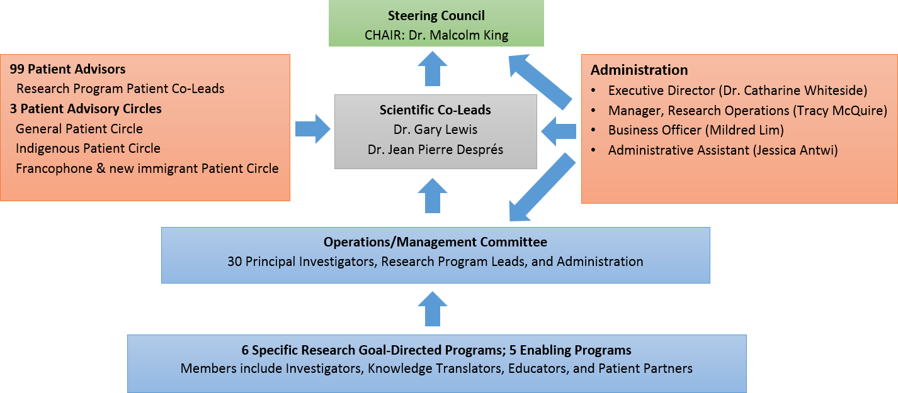

Slide 96
Patient engagement – our core success factor
Indigenous Circle
New Immigrants
Francophones
General Patient Circle
Lines represent connections with larger communities
of people living with diabetes

Slide 97
Patient Engagement – Strategies
Patient Partner representation should span all relevant populations, particularly the most vulnerable so that real health challenges are voiced
Patient Partners have the opportunity to work in groups where they are most comfortable, e.g., Indigenous Peoples, Francophone, but still enabled to have a voice among the larger Patient Partner Group, e.g., Collective Patient Circle
Patient Partner engagement can lead development of research questions and goals from the outset of a project or program
Patient Partner stories must be voiced and shared with the whole Network with opportunities to include in strategic communications.

Slide 98

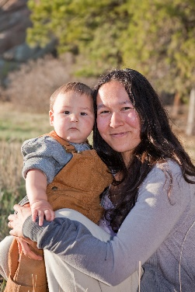

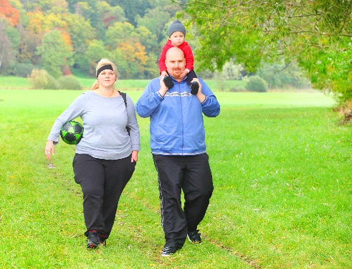

Thank You

Slide 99
Principles for PGD
Draft

Slide 100
Principles
Access – Patients as owners have a right to access their data
Transparency – Patients are informed who, how, what and why their data is being collected and used
Consent – Permission-based use of data – patients decide who
Trust – Patients trust governance and security of their data; purpose and integrity of those who collect and use their data
Purpose – Data is collected and used for a purpose that patients agree with eg: personal care or the greater good
Patient Partnership - patients are experts on their own data

Slide 101
Break

Slide 102
Group Discussion
Standards and Governance

Slide 103
Proposed standards
Involvement of patients/caregivers
Alignment with Principles for PGD
Clear governance structure for stewardship of PGD
Clear purpose for using PGD
Selection of PGD data in consultation with patient/caregiver partners
Easy collection and use of PGD

Slide 104
Proposed standards cont’d
Co-design consent mechanisms in consultation with patient/caregiver partners
Observe privacy laws for the appropriate jurisdictions
Data stored and backed up in a Canadian jurisdiction
Security measures in place and communicated clearly
Care providers to act proactively on PGD

Slide 105
Questions about governance- test use cases
What laws, regulations and policies need to be changed to establish good governance over PGD?
How should patients/caregivers be involved with data governance?

Slide 106
Patient Declaration of Values for Ontario
Respect and Dignity
We expect that our personal health information belongs to us, and that it remain private, respected and protected.
Accountability
We expect a health care culture that values the experiences of patients, families and caregivers and incorporates this knowledge into policy, planning and decision making.
Transparency
We expect our health records will be accurate, complete, available and accessible across the provincial health system at our request.

Slide 107
Opportunities for Moving Forward

Slide 108
Thank you

