Slide 1

Understanding the Collective Impact of
SPOR in Ontario
Workshop
Women’s College Hospital
January 21, 2019

Slide 2

Welcome
Marilyn Emery
CEO, Women’s College Hospital

Slide 3
Agenda
Time | Topic
9:00 – 9:05 | Welcome – Marilyn Emery
9:00 – 9:15 | Introductions and Objectives for the Day - Geoff Anderson
9:15 – 9:30 | The SPOR Enterprise in Ontario: Overview, opportunities and challenges - Catharine Whiteside
9:30 – 9:45 | Collective impact framework applied to SPOR: Focus on Common Agenda and Metrics - Onil Bhattacharyya
9:45 – 10:00 | Discussion – All
10:00 – 10:45 | Reports and Discussion on Activities and Agendas of Each SPOR Element in Ontario - All
10:45 – 11:00 | Break
11:00 – 11:15 | Evaluation and SPOR – Vasanthi Srinivasan and Eddy Nason
11:15 – 11:45 | Reports and Discussion on Evaluation Plans and Metrics of Each SPOR Element in Ontario - All
11:45 – 12:00 | Summary and Next Steps – Geoff Anderson
12:00 – 1:00 | Networking Lunch

Slide 4
Introductions and Objectives of the Day
Geoff Anderson

Slide 5
Introductions
Very Brief
  Your name
  The role you have that is relevant to today’s meeting

Slide 6
SPOR Goal and Vision
The goal of patient-oriented research is to better ensure the translation of innovative diagnostic and therapeutic approaches to the point of care, as well as to help the provinces and territories meet the challenge of delivering high quality, cost-effective health care. It involves ensuring that the right patient receives the right clinical intervention at the right time, ultimately leading to better health outcomes.
The vision of the Strategy for Patient-Oriented Research is to demonstrably improve health outcomes and enhance patients' health care experience through integration of evidence at all levels in the health care system.

Slide 7
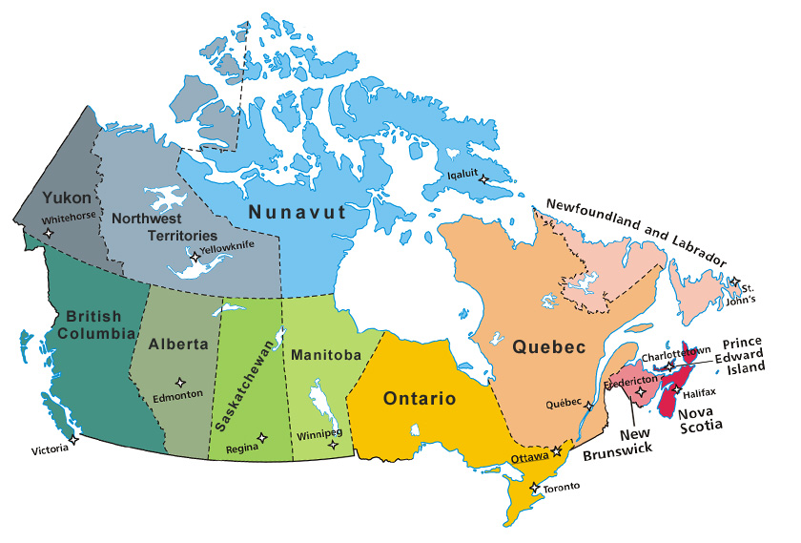

The SPOR
Enterprise
  1. SPOR Support Units (SU)
  2. SPOR Network in Youth and Adolescent Mental Health – ACCESS Canada
  3. Pan-Canadian SPOR Network in Primary and Integrated Health Innovations (PIHCI)
4. SPOR Networks in Chronic Disease
  Chronic Pain Network
  Chronic Kidney Disease (Can-SOLVE CKD)
  Child Disability and Brain Research (CHILD-Bright)
  Diabetes Action Canada (DAC)
  Gastro-Intestinal and Neuropsychiatric Effects (IMAGINE)
SU
SU
SU
SU
SU
SU
SU
SU
SU
SU

Slide 8
SPOR Enterprise in Ontario
Ministry of Health and Long-Term Care
Patrick Dicerni, ADM, Strategic Policy and Planning Division
Anne Hayes, Director, Research, Analysis and Evaluation Branch
SPOR Evidence Alliance
Lead: Andrea Tricco and Sharon Straus, Li Ka Shing Knowledge Institute, St Michael’s Hospital
SPOR Evidence Alliance
Lead: Andrea Tricco and Sharon Straus, Li Ka Shing Knowledge Institute, St Michael’s Hospital
Ontario SPOR SUPPORT Unit
Lead: A. Brown, Chair, Board of Directors and Vasanthi Srinivasan, CEO
BeACCoN
PIHCI Ontario Site
Lead: Geoff Anderson, Patrick Dicerni and Onil Batthacharrya (also PIHCIN-NCO Co-Chair)
Chronic Pain Network
Lead: Norm Buckley et al, McMaster University
Access Open Minds
SPOR Network in Youth and Adolescent Mental Health
Sites: Chatham-Kent
Diabetes Action Canada
Lead: Gary Lewis and Cathy Whiteside, UoToronto
IMAGINE
SPOR Network in Inflammation, Microbiome, Alimentation: Gastro-Intestinal and Neuropsychiatric Effects
Leads: Dr Paul Moayyedi, Dr Glenda MacQueen, Aida Fernandes, McMaster University
Can-SOLVE CKD
SPOR Network on Chronic Kidney Disease
Site: Ontario Renal Network, Cancer Care Ontario
Child Bright
SPOR Network on Brain Based Developmental Disabilities
Site: Steven Miller, SickKids
Solid line denotes formal relationship with MOHLTC / OSSU
Dotted line denotes no formal relationship with MOHLTC / OSSU

Slide 9
Context
Issue that faces all of SPOR enterprise at both national and provincial level
  SPOR 2.0 vision is being worked on at national level and will be on agenda at CIHR meeting middle of February 2019
  MOHLTC, broader provincial government and Ontario health care system in major transition/transformation
Issue that faces specific SPOR components
  OSSU renewal
  BeACCoN renewal

Slide 10
Common Evaluative Challenge
Canadian Institutes of Health Research: Evaluation of the Strategy for Patient-Oriented Research Final Report May 17, 2016
“CIHR should revise the existing SPOR performance measurement strategy to balance administrative/operational outputs with outcomes/impacts.”
“Indicators should be re-oriented from tracking primarily activity-based or output indicators toward outcomes and impacts; consider applying a “collective impact” lens.”

Slide 11
Objective
Share information and discuss two key aspects of collective impact – common agenda and common performance metrics
Provide input to both CIHR and MOHLTC on SPOR 2.0 and help BeACCoN and OSSU with their renewal

Slide 12
Agenda
Time | Topic
9:15 – 9:30 | The SPOR Enterprise in Ontario: Overview, opportunities and challenges - Catharine Whiteside
9:30 – 9:45 | Collective impact framework applied to SPOR: Focus on Common Agenda and Metrics - Onil Bhattacharyya
9:45 – 10:00 | Discussion – All
10:00 – 10:45 | Reports and Discussion on Activities and Agendas of Each SPOR Element in Ontario - All
10:45 – 11:00 | Break
11:00 – 11:15 | Evaluation and SPOR – Vasanthi Srinivasan and Eddy Nason
11:00 – 11:45 | Reports and Discussion on Evaluation Plans and Metrics of Each SPOR Element in Ontario - All
11:45 – 12:00 | Summary and Next Steps – Geoff Anderson
12:00 – 1:00 | Networking Lunch

Slide 13


The SPOR Enterprise in Ontario:
Overview, Opportunities and Challenges
Jan 21, 2019 BeACCoN, WCH

Slide 14
SPOR Enterprise in Ontario
In Canada…..
Largest provincial investment of resource supporting SPOR ($~150million over 5 years)
SPOR researchers continue to obtain more funding (CIHR and more)
Most diverse and comprehensive scope and scale of POR
OSSU
Recruited largest number of research centres and institutes focused on POR
New platforms for POR (data analytics, methods, clinical trials)
New strategic directions and pilot projects with patient engagement

Slide 15
SPOR Enterprise in Ontario
OUTCOMES
publications, presentations, communications
new multi-disciplinary collaborations and networking
researchers and Patient Partners understand the value of POR
Patient Partner engagement becoming influential in setting the research agenda
IMPACT
SPOR is changing the culture and focus of applied health research
Engagement of Public and Private Partners

Slide 16
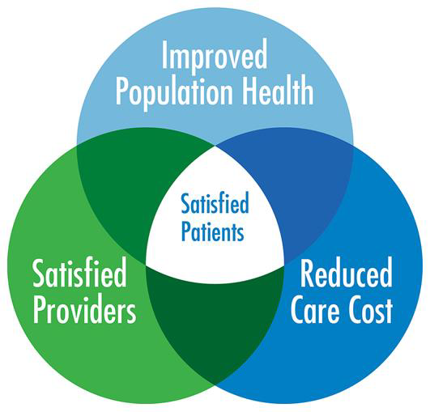
SPOR Focuses on ……..
…….to create LEARNING HEALTH ENVIRONMENTS

Slide 17
SPOR Enterprise in Ontario
HEALTH OUTCOMES and IMPACT ??
Have health outcomes in Ontario changed as a consequence of SPOR?
  What health outcomes are most likely to change?
  Will SPOR contribute to cheaper, better, faster healthcare?

Slide 18
The SPOR Opportunity
Premise:
Health care practice and systems will only change when patient-articulated needs are recognized, understood and effectively addressed;
Health policy must support effective change in health care practice and systems;
SPOR is a core enabler of timely change to practice and policy for the most complex, chronic conditions.

Slide 19
SPOR - Operational Framework
…….start with a high needs, high cost health problem
POR Phase 1 -
POR researchers establish relations with Patient Partners and create the opportunities for persons (at high risk) to identify their
most urgent challenges
e.g., Seniors living with diabetes and multiple chronic conditions, who are most likely to end up in acute care (heart and kidney failure, foot ulcers), with caregivers identify their health care needs

Slide 20
SPOR - Operational Framework
POR Phase 2 – identify gaps and potential solutions
Persons (at high risk) identify gaps in health care and support services
Health professionals and support service providers identify their needs to fill these gaps
Researchers search for evidence-based best practice solutions
e.g., Seniors living with diabetes and multiple chronic conditions require ongoing needs assessments in their homes to identify customized support services and interventions to improve self-management, prevent complications the need for acute care
Aging Community Health Research Unit – McMaster University

Slide 21
SPOR - Operational Framework
POR Phase 3 – design and conduct intervention
Patient Partners, researchers, health care professionals, community organizations and institutions work together to co-design real-world interventions and iterative evaluation to provide evidence for solutions
e.g., A Client-Driven Intervention to Support Self-Management among Community-Living Older Adults with T2D and Multiple Chronic Conditions
ACHRU – MOHLTC and CIHR pilot and feasibility study (RCT)

Slide 22




Community Partnership Program
T2D ≥ 65 yr with more than 2 chronic conditions
Home visits
Monthly Group Sessions
Monthly Nurse-led Case Conferences
Nurse-led Care Coordination
Source: CDC #14167



Source: CDC #13735
Notes:
A complex intervention with several interacting components
Participants were
offered 4 in-home visits
- delivered by RN and RD
invited to take part in 6 monthly group sessions
- light meal
- socializing time
- gentle exercise (* first assessed by a registered kinesiologist)
- interactive and flexible diabetes education and discussion
montly case-conferences
- client-centred
- evidence-based
nurse-led care coordination
- coordinate
- access services
- communication (pt, cg, team & primary care)
Group sessions & home visits:
Promote self-efficacy
Be comprehensive
Be flexible

Slide 23
2017 ACHRU Publication
Community Program Improves Quality of Life and Self- Management in Older Adults with Diabetes Mellitus
and Comorbidity
Markle-Reid M, et al. J of American Geriatrics Society
Sponsor’s (CIHR (IHSPR) + MOHLTC) Role:
The study design used an integrated KT approach which resulted in regular KT events with funding agencies to engage them in the research results and identification of policy implications.

Slide 24
SPOR - Operational Framework
POR Phase 4 - design and evaluate scale-up and spread
Patient Partners, researchers (implementation science), health care professionals (multiple disciplines), health system and policy decision-makers work together to design feasible, timely, cost-effective, scale-up and spread evaluation
e.g., ACHRU Community Partnership Program for Diabetes Self-Management for Older Adults in Canada
SPOR supported:
BeACCoN -> PIHCIN programmatic grant (Diabetes Action Canada match)
Ontario (Toronto), Quebec, Alberta, PEI (many SPOR Collaborators)
Ontario Knowledge Users: Patrick Dicerni, Phil Graham

Slide 25
SPOR – Success Factors and Challenges
Collaborative and Consistent Engagement of:
  Patient Partners (including caregivers)
  Health professionals and communities of practice
  Health system and policy decision-makers
  Sustained funding from multiple stakeholders
……. with SPOR investigators

Slide 26
The SPOR Opportunity in Ontario
All the SPOR elements and stakeholders
working together:
  SPOR SUPPORT Unit - Infrastructure and support
  SPOR Networks, iCTs, Evidence Alliance, Data Platform
  Health system and policy decision-makers
  Government, agencies and health care institutions
  Sponsoring stakeholders (CIHR, NGOs, private sector)
…….to achieve COLLECTIVE IMPACT

Slide 27

Collective Impact Framework Applied to SPOR: Focus on Common Agenda and Metrics
Onil Bhattacharyya
Frigon Blau Chair in Family Medicine Research
Clinical lead for Ontario, BeACCON
National Co-Chair, Primary and Integrated Health Care Innovation Network

Slide 28
From Isolated to Collective Impact
Isolated Impact
Funders select individual grantees
Groups work separately
Evaluate to isolate a particular group’s impact
Make large scale change by scaling organizations or projects
Communities and government loosely or disconnected.
Collective Impact
Funders understand that social problems – and solutions – arise from multiple interacting factors
Cross-sector alignment with government and community sectors as partners
Organizations actively coordinate their actions and share lessons learned
All work toward the same goal and measure the same things

Slide 29
The Collaboration Spectrum
Trust
Compete | Co-exist | Communicate | Cooperate | Coordinate | Collaborate | Integrate
Competition for clients, resources, partners, publicity. | No systematic connection between groups. | Some information sharing | As needed, often informal, interaction, on discrete activities or projects. | Groups adjust and align work with each other for greater outcomes. | Longer term interaction based on shared mission, goals; shared decision-makers and resources. | Fully integrated programs, planning, funding.
Turf
Loose
Tight

Slide 30
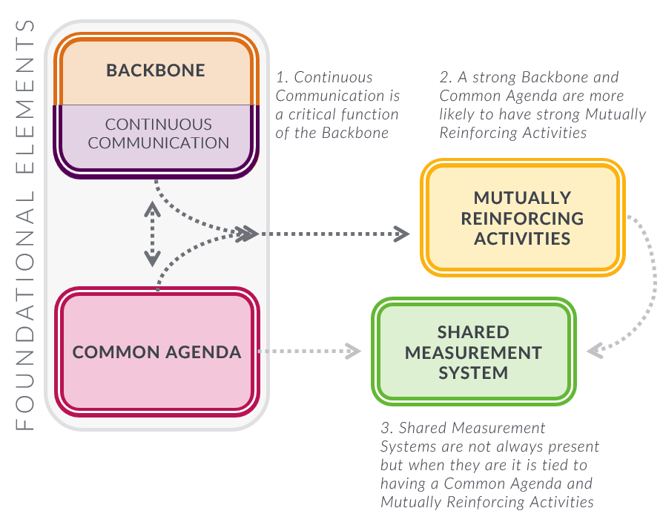
Achieving Collective Impact
Stawochiak & Gase, 2018

Slide 31
Components of a Common Agenda
Principles
Common Problem Definition
Goal
Framework for Change
Plan for Learning
Notes:
Principles
Agreed upon values that guide the group in laying out the rest of the common agenda, making decisions, and how the group is going to work together overall.
Common Problem Definition
A common understanding of the problem the group is trying to solve. Often this involves establishing boundaries for what issues, players, and systems the group will in engage with, and which are outside its scope. The problem definition is built on a shared understanding of the root causes of the issue at hand.
Goal
A measurable, population level goal that demonstrates how you will define success.
Framework for Change
A structure for how the group will split up the work (into working groups, backbone roles, policy groups, etc.) and prioritize limited resources.
Plan for Learning
A plan for how you intend to track your progress and learn from your efforts as an initiative.

Slide 32
Example: Unidos Contra Diabetes guiding principles
Serve the whole community through a systems oriented approach
2. Take an asset-based approach
3. This is everyone’s responsibility
4. Think holistically about health
5. Empower people and families
Notes:
1. Serve the whole community through a systems oriented approach We support not only the individuals at risk for diabetes, but also their families and the communities they live in. We strive to change the overall system, including policies, practices and culture and norms to create a healthier community
2. Take an asset-based approach
We will view all families and individuals as assets to build upon and avoid shaming people for poor health
3. This is everyone’s responsibility
Diabetes prevention is a shared responsibility of the entire community, including the private sector, governments, schools, families, and individuals at risk for diabetes
4. Think holistically about health
We believe that supporting health means promoting mind, body, and spiritual wellness
5. Empower people and families
We commit to empowering individuals and families with the knowledge and cost- effective care and tools they need to take their health into their own hands

Slide 33
Defining The Problem
Set boundaries
Use quality data to inform thinking
Allow it to change over time

Slide 34
Setting a Goal
Choose a goal that can be measured
Make it audacious and inspiring
Consider equity
Setting a Goal

Slide 35
Framework for Change
Structure how the group will split up the work
  Working groups, policy group, roles
Determine how to prioritize limited resources
Setting a Goal

Slide 36
Planning for Learning and Evaluation
Incorporate early thoughts on shared measures
Note change on different scales
Strongly emphasize learning

Slide 37
Thinking About Shared Measurement
Shared Measurement
Process: # of people/orgs at table, # of community presentations, articles, etc
Progress: # of programs, # of new initiatives, etc
Policy: policy changes in own or other organizations, new investments, gov. policy changes
Population : # of people moved out of poverty, # of high school graduates, # of low birth weight babies

Slide 38



Collective Impact on the ground- SPOR as a catalyst
Collective Impact Factor | Case study for chronic disease management (Diabetes and complex needs)
1. Common agenda | MoU with Toronto Central regional authority joining up to align agenda around population-health planning for people with diabetes and complex needs (DAC/PICHIN projects)
2. Shared Measurement System | Leveraging data assets and analytical capacity from IC/ES via OSSU partnership
3. Mutually reinforcing activities | Co-designed interventions from researchers, targeting key populations in sub-regions (Diabetes interventions)
4. Continuous Communication | Regular working groups formed to facilitate evidence-sharing and data for monitoring and planning
5. Backbone Organization | Testing the feasibility of an on-going platform (data, resources, strategy) to support alignment on the ground

Slide 39
Reports and Discussion on Agenda and Success Stories of Each SPOR Element in Ontario

Slide 40
ACCESS Open Minds Network
Agenda:
To provide timely access to evidence-informed, youth-friendly, and situation-appropriate mental health care across the entire spectrum of mental health problems; and
Create pan-Canadian network of youth, families/carers, service providers, researchers and decision makers from diverse contexts across Canada
Generating new knowledge about youth mental health care across Canada (what works, in what contexts and why)
Focus: Youth and their families/carers in need of mental health services, service providers, service planners
Sectors: Primary care, specialist services, peer support, social & community services
Key Projects:
Optimizing local services to create integrated youth mental health service sites across Canada (14 sites in 6 provinces 1 territory)
Helping service providers, managers, and clinical leaders across Canada transform services through optimizing local resources, integration of meaningful evaluation/research into care and engagement of youth, families and carers in service planning and research
Creating a diverse national network

Slide 41
ACCESS Open Minds’ SPOR Success Story
AOM has transformed youth mental health field in Canada through:
  Created the momentum for and informing policy and funding commitments to youth mental health in Canada – Quickly influencing priorities unlike traditional research. Examples include YWHO (Ontario), Foundry (BC), Aires ouvertes (Quebec), ACCESS OM NB, FRAYME etc.
  Having a direct, immediate impact on thousands of Canadian youth seeking help for mental health issues
  Improved services from the ground up, based on evidence informed service design framework (change management, training & capacity building)
  Integrating evaluation and research directly into practice (shortening the gap in research -> implementation)
  Creating a first of it’s kind dataset that will provide a national snapshot of youth mental healthcare across diverse contexts in Canada
Project innovations (so far):
  Designed & implemented evaluation protocol in consultation with youth, families/carers, researchers and service planners
  Designed and implemented innovative clinical model (ACCESS Clinician), training/capacity building program for clinicians and research staff across the country
  Created an online data platform that provides meaningful feedback to clinicians, service planners and researchers in real-time
  Creating a multi-stakeholder network, connecting Indigenous and non-Indigenous partners from across Canada

Slide 42
BeACCoN (Better Access and Care for Complex Needs) PIHCI Network
Agenda: Facilitate innovation to improve integrated and primary care for people with complex needs in Ontario
Focus: Innovations that focus on multi-sector integration, upstream prevention strategies and care delivery models. Aimed at complex-needs and high cost users across the life course (children, adults and older people)
Generate evidence on the impacts of innovations on health outcomes, experience and cost to support evidenced-informed scale up and system transformation
Sectors: Primary, community, social determinants (housing, social services, etc)
Key Projects: patient-generated data, common metrics for complex needs, rapid cycle learning for health system planning, segmentation of complex populations

Slide 43
BeACCoN’s SPOR Success Story
Patient-Generated Data
  Worked with patient and caregiver partners to hold workshop with stakeholders from policy, research, industry to identify key questions and issues around patient-generated data
  Co-designed an approach to addressing the gaps: framework and guidelines for patient-generated data
  Commissioned patient group (funding, in-kind) to undertake project to develop principles for patient-generated data in Ontario
  Project will also address consultative engagement of patients and the public on the principles and will include communications and knowledge translation to key stakeholders in the province

Slide 44




Listening, Learning, Leading: Canadians Seeking Solutions and Innovations to Overcome Chronic Kidney Disease | Can-SOLVE CKD Network
GOAL: transform kidney treatment and care
PATIENT ENGAGEMENT: embedded in all aspects of our research network
18 research projects across 3 main themes
  Earlier diagnosis
  Better treatments
  Innovative care

Slide 45
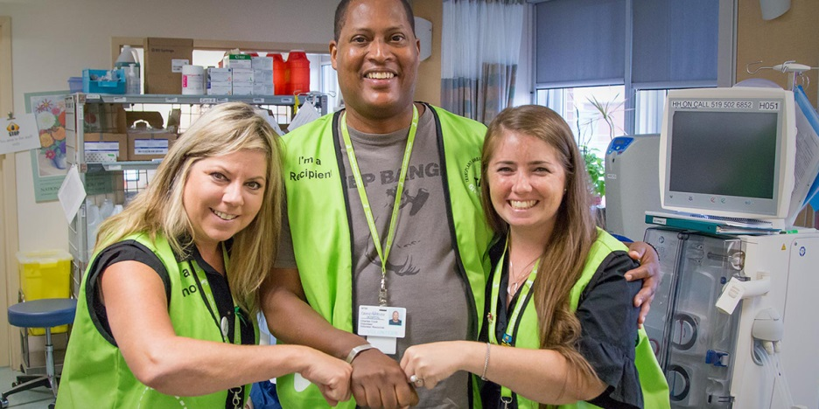
Can-SOLVE CKD Success Story:
Increasing Living Donor Kidney Transplantation Transplant Ambassador Program (TAP) www.transplantambassadors.ca
PI: Dr. Amit Garg
Patient-led initiative connecting previous kidney donors/recipients with potential donors/recipients
Peer-mentorship and support to overcome barriers to donation
Informed by 2016 workshop with donors, recipients, family members
Rolled out in 13 regional renal clinics in Ontario
Notes:
How we worked with patients to identify gaps
How we co-designed new model(s)/intervention(s) to address the gaps
How we conducted research/generated evidence on how/whether the new model/intervention worked
How we translated the evidence into improvements for patients/providers/policy

Slide 46





  CHILD-BRIGHT Network
Agenda: Making the future brighter for children with brain-based developmental disabilities and their families
Focus: In Canada, as many as 850,000 children under the age of 14 are living with a brain-based developmental disability and face life-long challenges with mobility, language, learning, socialization, and/or self-care that impact the quality of their lives.
At CHILD-BRIGHT, patients, families, researchers, clinicians, policy makers and other key stakeholders work together to improve health care systems, practices, and knowledge to ensure better outcomes for these children and their families.
Sectors: Spectrum of health care, from acute intensive care to community; fetal to emerging young adults
Key Projects: Research projects
+
(6 projects)
POR training program, knowledge translation program, data coordinating centre and health economics services
(4 projects)
(3 projects)

Slide 47

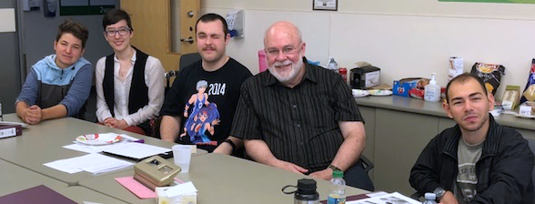
  CHILD-BRIGHT’s SPOR Success Story
CHILD-BRIGHT’s National Advisory Youth Panel (NYAP)
8 youth advisors across Canada, ages 16-29, with brain-based developmental disabilities
Provides our network with the youths’ lived experience lens to our projects and activities by advising on:
Research protocols
Recruitment strategies
Communication plans
Dissemination activities
Consultation with NYAP will be available to external research teams shortly

Slide 48

Chronic Pain Network
Agenda: To direct new research in chronic pain, train researchers and clinicians, and translate findings into knowledge and policy.
Focus: Chronic pain
Sectors: Patients, researchers, healthcare professionals, educators, industry and government policy advisors
Key Projects: Includes more than 20 research projects, a clinical research network, a registry working group, an Indigenous Health Research Advisory committee.

Slide 49

Chronic Pain Network’s SPOR Success Story
Pain+CPN
  A premium literature service that pulls pain-related articles from more than 110 journals. Eligible articles are rated for clinical relevance and newsworthiness by doctors, clinicians and other healthcare professionals
    Knowledge Translation committee worked together to expand raters to include patient perspective partners to better identify patient interests and informational needs
    Incorporated the introduction of lay summaries, geared towards patient-users, to help better facilitate conversations between patients and their healthcare providers
    Looking to increase number of patient raters and healthcare raters and increase frequency of lay summary production
    painpluscpn.ca

Slide 50
Diabetes Action Canada
Agenda: To develop patient- and research-informed innovations in equitable health care delivery designed to prevent diabetes and its related complications and to achieve the Quadruple Aim goals.
Focus: Catalyzing the scaling-up of effective health care solutions that directly improve outcomes for persons living with diabetes, particularly the most vulnerable, by addressing the barriers to prevention and treatment of diabetes complications that are most important to our Patient Partners.
Sectors: Persons living with diabetes, primary and community healthcare providers, specialists, and advocacy organizations. (Policy decision-makers)
Key Projects: Digital Health Solutions (national repository, T1D Registry, bant); Indigenous Youth Mentorship Program; Community-engaged Care for Seniors with Diabetes; Prevention of diabetic retinopathy and foot ulcers; building capacity in patient engagement and patient-oriented research.

Slide 51
Diabetes Action Canada’s SPOR Success Story
Patient-Oriented Research in Action
  T1D Registry: a patient engagement tool co-designed with individuals living with T1D. Through an innovative workshop and planning process the Registry has been redesigned to address the unique needs of the T1D community.
  Indigenous Youth Mentorship Program (IYMP): enabling the rippling out of the successful IYMP program (co-developed by researchers, Indigenous communities and elders) from 5 sites in Manitoba to over 30 sites across the country including Northern Ontario communities.
  Foot Care to Prevent Lower Limb Amputations: new research group emerged based on Patient Partner advice. Chiropody-led multi-centre iCT now funded. St. Michael’s leading new comprehensive, multi-disciplinary care path

Slide 52
SPOR Evidence Alliance
Agenda: To improve the Canadian health system by providing access to high-quality scientific information synthesized to meet the needs of decision-makers, such as patients, healthcare providers, and policy-makers
Focus: Knowledge Synthesis, Knowledge Translation & Implementation, and Clinical Practice Guidelines with a strong emphasis on decision-maker and patient engagement
Sectors: Researchers, research trainees, patient partners, healthcare providers, policy makers, and other decision-makers
Key Initiatives: Knowledge user-initiated research queries, searchable database of Canadian Clinical Practice Guidelines, as well as training and mentorship

Slide 53
SPOR Evidence Alliance’s Success Story
Alliance Governance:
The Alliance has oversight from six committees to ensure progress towards its vision and goals are on track
Each committee has reserved seats for patient partners
  Five of the committees are co-chaired by a patient partner
Patient partners, researchers, trainees and knowledge-users worked together in the Alliance’s inaugural year on the following:
  Branding of the Alliance
  Patient engagement strategy and compensation policy for Alliance activities
  Training and mentorship strategy
  Assessing patient engagement opportunities in research queries received through our query services

Slide 54
Inflammation, Microbiome, and Alimentation: Gastro-Intestinal and Neuropsychiatric Effects: the IMAGINE-SPOR Chronic Disease Network
Agenda: To develop innovative therapies for Irritable Bowel Syndrome (IBS) and Inflammatory Bowel Disease (IBD) and their associated mental health disorders.
Focus: Irritable Bowel Syndrome (IBS) and Inflammatory Bowel Disease (IBD) and mental health
Sectors: Specialist (Gastroenterology & Psychiatry)
Key Projects: Establish legacy patient cohort to develop innovative therapies, improve outcomes of existing therapies, develop strategies to optimize current therapies

Slide 55
IMAGINE-SPOR’s Success Story
PACE Quality Indicators to Improve IBD Care Delivery
  Partnered with Crohn’s and Colitis Canada’s PACE Program
  Active involvement of patient representatives to develop and select a comprehensive list of Quality Indicators (QI) for IBD management
  Variable clinical practice exists in many aspects of IBD care
  QIs hold great potential to advance best practices for medical professionals and elevate the standard of care for patients
  Patients are the ultimate beneficiaries of any healthcare improvement program, therefore this initiative engaged patients throughout the methodological process
  Ensure that aspects of IBD care of importance to the Canadian patient population were considered
  Implementation: 12 of the 45 QI indicators (amenable to patient self-reporting) incorporated in a smartphone app (HealthPromise) used by IBD patients.

Slide 56

Ontario SPOR Support Unit
Mandate: To shift Ontario’s culture of health research to one with a patient oriented, networked and impact driven paradigm for the benefit of health, health policy and healthcare in the province
Focus: Patient-oriented research support and excellence
Sectors: ‘Patients’, researchers, policy makers, health professionals, industry, health administrators/managers, the public
Key Areas: Consultation support, patient engagement, patient oriented research methods, pragmatic trails, indigenous health, francophone health, sex and gender, data, capacity building, knowledge translation, demonstration projects

Slide 57

OSSU’s SPOR Success Story
OSSU Demonstration Projects (IMPACT Awards)
OSSU funded 17 demonstration projects across Ontario, to showcase the value and impact POR can have in the province when paired with POR support.
Funded IMPACT Awards were all co-designed with patient partners to fit with patient-identified needs
In the selection process for projects, patient partners, health professionals and decision makers worked with academics on reviewing proposals for potential impacts and patient centredness.
Patient partners on projects were also part of the interview process for proposing groups, in order to understand how patient partners had been, and would be, involved in the proposed project
All of the successful projects had to showcase how their work would be implementable and scalable in the province, as well as being required to work with at least three OSSU Research Centres
IMPACTS
Many projects have already produced impacts, including:
  CLEAN Meds: the work on providing free medications has impacted Ontario and Canadian conversations on pharmacare, as well as providing much need medication to individuals who may not have been able to comply with their prescriptions
  YouthCan IMPACT: the approach to youth mental health services is now being rolled out across the province in association with MOHLTC
  First Nations Diabetes: has changed the information available to First Nations on diabetes, as well as exemplifying how POR can work with FN communities
  Ontario Healthcare Implementation Laboratory: Working with HQO to create patient-partnered changes to quality improvement in Ontario’s health system and embedding it in the quality system

Slide 58
Discussion

Slide 59
BREAK
10:45 – 11:00

Slide 60

Research Evaluation and SPOR in Ontario
January 21st 2019
Eddy Nason
Assistant Director, Ontario SPOR SUPPORT Unit

Slide 61
To cover
What is evaluating research?
What’s the trend in this work?
What’s evaluation in SPOR all about?
What do we need to do to understand impact / ROI in Ontario for SPOR?

Slide 62

Research evaluation – research on research
Evaluating research can be considered to be for one or more of four reasons (4A’s)
Two key issues to address:
  Capturing impacts as they fan out from research
  Categorizing impacts
INPUT
…
…
PROCESS
…
…
OUTPUT
…
…

Slide 63

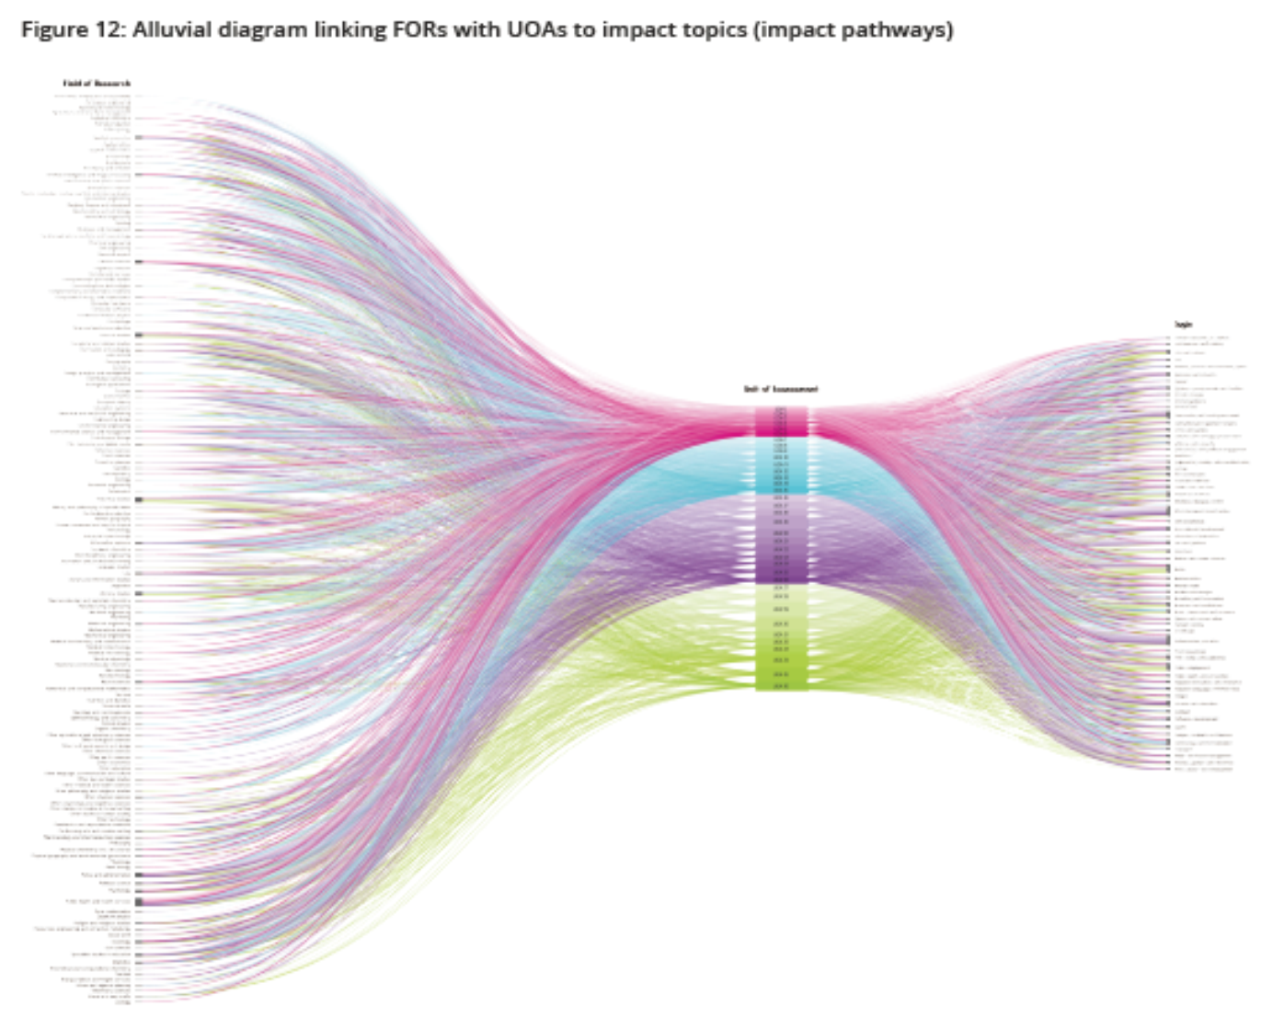



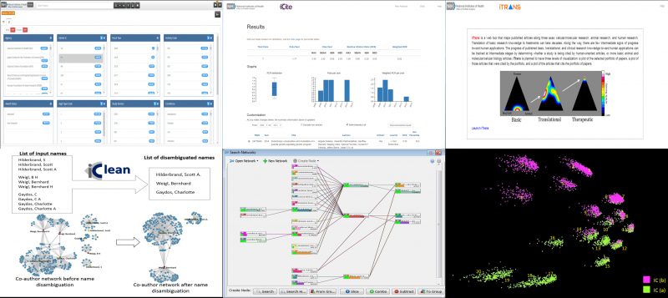
The state of the art

Slide 64
Narratives vs. metrics
Narratives
Impact narratives allow large amounts of complex impact information to be collated and stated
Impact narratives require organization and thought
There are processes to go through to build impact narratives
There are templates and guidance available to you
Impact narrative analysis can be tough but worthwhile
Metrics
Impact metrics provide easily comparable year-on-year data
Metrics can be subject to both statistical analysis and targets
Common metrics can be easily compared across evaluations
Metrics tend to be reductive and miss impacts
Metrics are subject to misinterpretation and gaming
Metrics drive behaviour (often in unexpected ways)

Slide 65
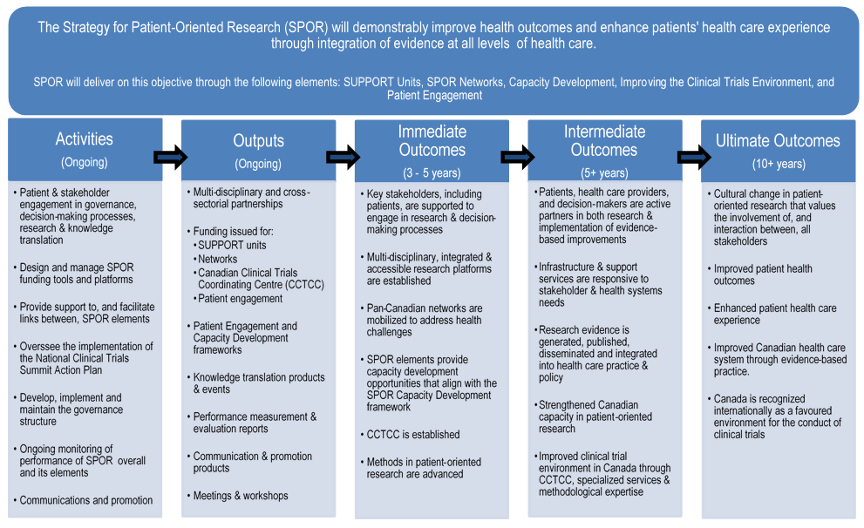
Evaluation in SPOR

Slide 66
Evaluation in SPOR
Impact conversation has switched since the 5-year SPOR evaluation to one that focuses on:
Collective impact
Stronger focus on ultimate outcomes
Acceptance of the challenge of metric-based approaches
Attempt to clarify evaluation vs. performance measurement

Slide 67




Understanding impact / ROI of SPOR in Ontario

Slide 68

For more information:
Contact:
Eddynason@ossu.ca
Further reading
Metrics: “The Leiden Manifesto for Research Metrics”
http://www.leidenmanifesto.org/
ROI: “Medial Research: What’s it Worth?”
https://www.rand.org/pubs/external_publications/EP20080010.html
Narratives: Writing impact narratives
http://www.mayaproject.org/blog/2015/10/16/how-to-write-a-winning-research-impact-case-study

Slide 69
Reports and Discussion on Evaluation Plans and Metrics of Each SPOR Element in Ontario

Slide 70
ACCESS Open Minds
Evaluation & Metrics
Progress to date on Evaluation:
  Common evaluation protocol implemented/collected at 12 of 14 sites across Canada; data collection ongoing to September 2020
  Supplement describing service transformation/innovation in seven diverse contexts to be published in Spring 2019
Key metrics for evaluation (of our SPOR):
  Innovation in evaluation and research: creation of stakeholder informed, meaningful evaluation protocol for ymh field which takes into account patient perspectives
  New knowledge about YMH in Canada: Truly Canadian (e.g. diverse) picture of services across Canada & evidence base for future service design/planning
  Connected the country (network): positive collaboration between Indigenous and non-Indigenous partners, and other diverse stakeholders across Canada (researchers & non-researchers)
  Capacity building: training and building capacity for clinicians and local staffing (TRC call to actions #23 & #66)
  Scaling across Canada & ensuring policy is evidence based: evaluation protocol is already influencing provincial policy investments (YWHO, Foundry)

Slide 71
BeACCoN’s Evaluation & Metrics
Progress to date on Evaluation:
  Interim Evaluation report completed at 1.5 Years of BeACCoN
  Planning for network renewal (2020) with focus on collective impact
Key metrics for evaluation:
  Infrastructure development to support research and innovation in primary and integrated care in Ontario
    Common measures for complex needs populations
    Patient engagement in research
    Policy maker engagement to define and refine research priorities
    Data backbone for evaluation and quality improvement for the province including primary care and patient-generated data
  Networking researchers, policymakers and patient partners across the province and Canada to collaborate
  Knowledge Translation of evidence to decision-making
    Impact of research in policy

Slide 72
Can-SOLVE CKD Evaluation and Metrics
Progress to date on Engagement:
  Patient partnering in all activities of Network
  Leadership: Patient Council and IPERC
  Steering Committee Membership
  Identified Patient co-leads in Research Projects
  Members of Research Operating Committee (ROC)
  Co-authorship (Can J Kidney Health Dis. 2018 Jan 17)
  Co-investigator Status (CIHR SPOR and CIHR ATTEMPT)
Key metrics for Evaluation:
  Annual Reviews of Research Projects (ROC)
  Patient Engagement Check-in Calls & PE Surveys
  Ongoing delivery of Foundations in POR training
  Co-creation of 5 unique learning branches (e.g. Storytelling & Wabishki Bizhiko Skaanj Learning Pathway)

Slide 73
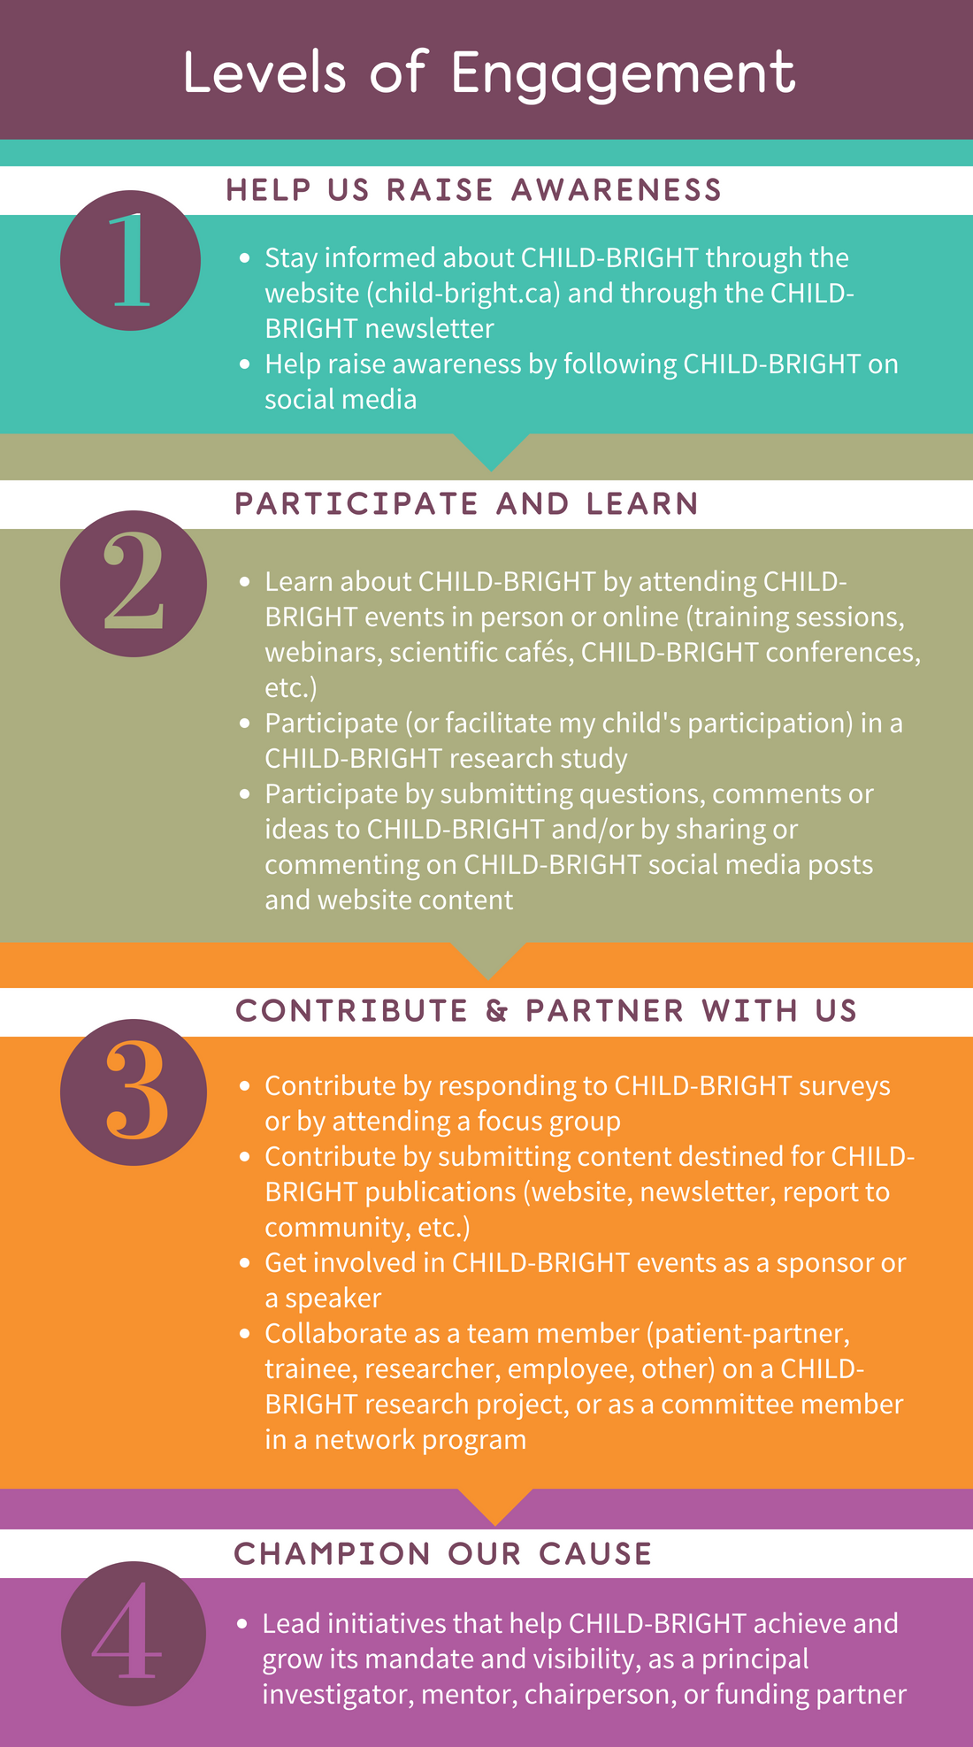




  CHILD-BRIGHT Evaluation & Metrics
We developed a levels of engagement framework and are recording empirical evidence against this framework, using standardized measures of partnership and trust (CIROP, CBPR)

Slide 74
Chronic Pain Network Evaluation & Metrics
Progress to date on Evaluation:
  Evaluation of the patient engagement structures, processes and activities relying on three primary data sources: organizational documents, questionnaires and interviews
  Occurs every 6 months for the duration of the network provides input on current structures and processes and areas to improve on as well as outputs through to the end of the current mandate.
Key metrics for evaluation:
  Number of patient partners involved and quality of patient involvement
    In the areas of Network governance and research projects including the National Chronic Pain Registry, Clinical Research Network and Indigenous Health Advisory Committee

Slide 75
Diabetes Action Canada Evaluation & Metrics
Progress to date on Evaluation:
  Steering Council Performance Committee advises on reporting outcomes and impact to address Patient Partner challenges
  Network evaluation and ROI led by Dr. Valeria Rac from the THETA collaborative in Toronto
  External scientific review – Fall 2019
Key metrics for evaluation:
  11 Programs reporting quantitative and qualitative outcomes based on logic model activities/projects
  Narratives to communicate with public, policy-makers and sponsors
  POR measures – in context articulating impact on researchers, Patient Partners, Trainees, health care providers, policy decision-makers.

Slide 76
SPOR Evidence Alliance Evaluation & Metrics
Progress to date on Evaluation:
The Alliance plans to evaluate the impact of its query services with a client satisfaction survey at the conclusion of each project
The Alliance will begin conducting annual survey of patient partners to formally assess the overall effectiveness and limitations of all the different patient engagement activities
An annual survey of participants will be conducted to gather information on perceptions and experiences with the various capacity-building activities
Key metrics for evaluation:
Decision impact: number of decisions influenced, usefulness, relevance and timeliness of information provided, etc.
Training and mentorship: number of courses offered, number of trainees, knowledge users and patient partners engaged in research, impact on professional/training development, etc.
Networking: collaborations and linkages established, etc.
Knowledge: measuring research outputs and quality, research visibility and uptake, advances in methods, etc.

Slide 77
IMAGINE Evaluation & Metrics
Progress to date on Evaluation:
  Year 1 & 2 Annual report
  Monthly recruitment reports
  Capacity building, publication & awareness metrics
  Expert Advisory Panel
Key metrics for evaluation:
  IMAGINE’s Legacy cohort
    Requests for data
    Publications stemming from data
    Spin off funding, projects
  Case studies

Slide 78
OSSU
Evaluation & Metrics
Progress to date on Evaluation:
  OSSU’s Interim evaluation (3-year) was concluded in 2017
  OSSU is currently in the process of starting its 5-year evaluation (commencing 2019)
Key metrics for evaluation:
  In order to align with SUPPORT Units across the country, OSSU works within the impact framework of CIHR’s SPOR enterprise
  Key indicators include:
    Measures of output (publications, capacity built, etc.)
    Measures of reach (stakeholders engaged in activities, non-academic outputs, etc.)
    Measures of outcome (impact narratives, identification of qualitative impacts on policy, practice and the research system)
  Aligned with international best practice and new evidence on research impact assessment, OSSU is predominantly focused in evaluations on impact narratives that note the contribution of OSSU activities to broad societal impacts

Slide 79
Summary and Next Steps

