Slide 1
Understanding the Collective Impact of SPOR in Ontario
Workshop
Women’s College Hospital
January 21, 2019

Slide 2
Agenda
Time | Topic
9:00 – 9:05 | Welcome – Marilyn Emery
9:00 – 9:15 | Introductions and Objectives for the Day - Geoff Anderson
9:15 – 9:30 | The SPOR Enterprise in Ontario: Overview, opportunities and challenges - Catharine Whiteside
9:30 – 9:45 | Collective impact framework applied to SPOR: Focus on Common Agenda and Metrics - Onil Bhattacharyya
9:45 – 10:00 | Discussion – All
10:00 – 10:45 | Reports and Discussion on Activities and Agendas of Each SPOR Element in Ontario - All
10:45 – 11:00 | Break
11:00 – 11:15 | Evaluation and SPOR – Vasanthi Srinivasan and Eddy Nason
11:15 – 11:45 | Reports and Discussion on Evaluation Plans and Metrics of Each SPOR Element in Ontario - All
11:45 – 12:00 | Summary and Next Steps – Geoff Anderson
12:00 – 1:00 | Networking Lunch

Slide 3
Reports and Discussion on Agenda and Success Stories of Each SPOR Element in Ontario

Slide 4
ACCESS Open Minds Network
Agenda:
To provide timely access to evidence-informed, youth-friendly, and situation-appropriate mental health care across the entire spectrum of mental health problems; and
Create pan-Canadian network of youth, families/carers, service providers, researchers and decision makers from diverse contexts across Canada
Generating new knowledge about youth mental health care across Canada (what works, in what contexts and why)
Focus: Youth and their families/carers in need of mental health services, service providers, service planners
Sectors: Primary care, specialist services, peer support, social & community services
Key Projects:
Optimizing local services to create integrated youth mental health service sites across Canada (14 sites in 6 provinces 1 territory)
Helping service providers, managers, and clinical leaders across Canada transform services through optimizing local resources, integration of meaningful evaluation/research into care and engagement of youth, families and carers in service planning and research
Creating a diverse national network

Slide 5
ACCESS Open Minds’ SPOR Success Story
AOM has transformed youth mental health field in Canada through:
Created the momentum for and informing policy and funding commitments to youth mental health in Canada – Quickly influencing priorities unlike traditional research. Examples include YWHO (Ontario), Foundry (BC), Aires ouvertes (Quebec), ACCESS OM NB, FRAYME etc.
Having a direct, immediate impact on thousands of Canadian youth seeking help for mental health issues
Improved services from the ground up, based on evidence informed service design framework (change management, training & capacity building)
Integrating evaluation and research directly into practice (shortening the gap in research -> implementation)
Creating a first of it’s kind dataset that will provide a national snapshot of youth mental healthcare across diverse contexts in Canada
Project innovations (so far):
Designed & implemented evaluation protocol in consultation with youth, families/carers, researchers and service planners
Designed and implemented innovative clinical model (ACCESS Clinician), training/capacity building program for clinicians and research staff across the country
Created an online data platform that provides meaningful feedback to clinicians, service planners and researchers in real-time
Creating a multi-stakeholder network, connecting Indigenous and non-Indigenous partners from across Canada

Slide 6
BeACCoN (Better Access and Care for Complex Needs) PIHCI Network
Agenda: Facilitate innovation to improve integrated and primary care for people with complex needs in Ontario
Focus: Innovations that focus on multi-sector integration, upstream prevention strategies and care delivery models. Aimed at complex-needs and high cost users across the life course (children, adults and older people)
Generate evidence on the impacts of innovations on health outcomes, experience and cost to support evidenced-informed scale up and system transformation
Sectors: Primary, community, social determinants (housing, social services, etc)
Key Projects: patient-generated data, common metrics for complex needs, rapid cycle learning for health system planning, segmentation of complex populations

Slide 7
BeACCoN’s SPOR Success Story
Patient-Generated Data
Worked with patient and caregiver partners to hold workshop with stakeholders from policy, research, industry to identify key questions and issues around patient-generated data
Co-designed an approach to addressing the gaps: framework and guidelines for patient-generated data
Commissioned patient group (funding, in-kind) to undertake project to develop principles for patient-generated data in Ontario
Project will also address consultative engagement of patients and the public on the principles and will include communications and knowledge translation to key stakeholders in the province

Slide 8
Listening, Learning, Leading: Canadians Seeking Solutions and Innovations to Overcome Chronic Kidney Disease | Can-SOLVE CKD Network
GOAL: transform kidney treatment and care
PATIENT ENGAGEMENT: embedded in all aspects of our research network
18 research projects across 3 main themes
Earlier diagnosis
Better treatments
Innovative care

Slide 9
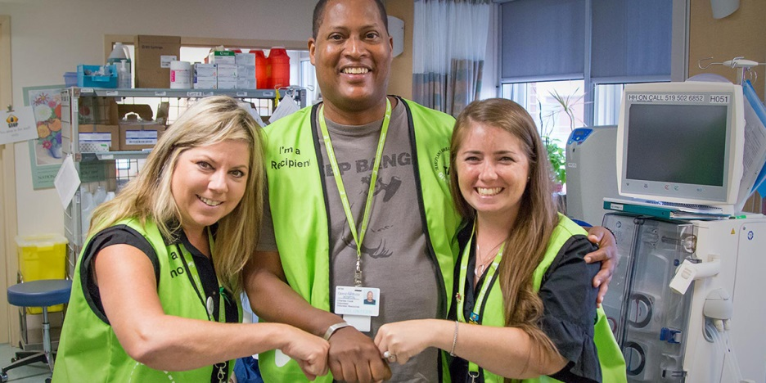
Can-SOLVE CKD Success Story: Increasing Living Donor Kidney Transplantation Transplant Ambassador Program (TAP) www.transplantambassadors.ca
PI: Dr. Amit Garg
Patient-led initiative connecting previous kidney donors/recipients with potential donors/recipients
Peer-mentorship and support to overcome barriers to donation
Informed by 2016 workshop with donors, recipients, family members
Rolled out in 13 regional renal clinics in Ontario
Notes:
How we worked with patients to identify gaps
How we co-designed new model(s)/intervention(s) to address the gaps
How we conducted research/generated evidence on how/whether the new model/intervention worked
How we translated the evidence into improvements for patients/providers/policy

Slide 10
CHILD-BRIGHT Network
Agenda: Making the future brighter for children with brain-based developmental disabilities and their families
Focus: In Canada, as many as 850,000 children under the age of 14 are living with a brain-based developmental disability and face life-long challenges with mobility, language, learning, socialization, and/or self-care that impact the quality of their lives.
At CHILD-BRIGHT, patients, families, researchers, clinicians, policy makers and other key stakeholders work together to improve health care systems, practices, and knowledge to ensure better outcomes for these children and their families.
Sectors: Spectrum of health care, from acute intensive care to community; fetal to emerging young adults
Key Projects: Research projects
+
(6 projects)
POR training program, knowledge translation program, data coordinating centre and health economics services
(4 projects)
(3 projects)

Slide 11
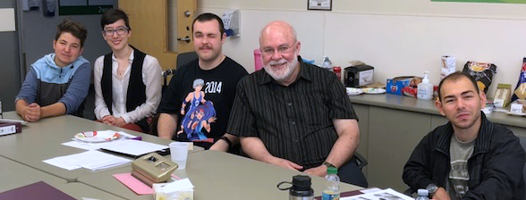
CHILD-BRIGHT’s SPOR Success Story
CHILD-BRIGHT’s National Advisory Youth Panel (NYAP)
8 youth advisors across Canada, ages 16-29, with brain-based developmental disabilities
Provides our network with the youths’ lived experience lens to our projects and activities by advising on:
Research protocols
Recruitment strategies
Communication plans
Dissemination activities
Consultation with NYAP will be available to external research teams shortly

Slide 12
Chronic Pain Network
Agenda: To direct new research in chronic pain, train researchers and clinicians, and translate findings into knowledge and policy.
Focus: Chronic pain
Sectors: Patients, researchers, healthcare professionals, educators, industry and government policy advisors
Key Projects: Includes more than 20 research projects, a clinical research network, a registry working group, an Indigenous Health Research Advisory committee.

Slide 13
Chronic Pain Network’s SPOR Success Story
Pain+CPN
A premium literature service that pulls pain-related articles from more than 110 journals. Eligible articles are rated for clinical relevance and newsworthiness by doctors, clinicians and other healthcare professionals
Knowledge Translation committee worked together to expand raters to include patient perspective partners to better identify patient interests and informational needs
Incorporated the introduction of lay summaries, geared towards patient-users, to help better facilitate conversations between patients and their healthcare providers
Looking to increase number of patient raters and healthcare raters and increase frequency of lay summary production
painpluscpn.ca

Slide 14
Diabetes Action Canada
Agenda: To develop patient- and research-informed innovations in equitable health care delivery designed to prevent diabetes and its related complications and to achieve the Quadruple Aim goals.
Focus: Catalyzing the scaling-up of effective health care solutions that directly improve outcomes for persons living with diabetes, particularly the most vulnerable, by addressing the barriers to prevention and treatment of diabetes complications that are most important to our Patient Partners.
Sectors: Persons living with diabetes, primary and community healthcare providers, specialists, and advocacy organizations. (Policy decision-makers)
Key Projects: Digital Health Solutions (national repository, T1D Registry, bant); Indigenous Youth Mentorship Program; Community-engaged Care for Seniors with Diabetes; Prevention of diabetic retinopathy and foot ulcers; building capacity in patient engagement and patient-oriented research.

Slide 15
Diabetes Action Canada’s SPOR Success Story
Patient-Oriented Research in Action
T1D Registry: a patient engagement tool co-designed with individuals living with T1D. Through an innovative workshop and planning process the Registry has been redesigned to address the unique needs of the T1D community.
Indigenous Youth Mentorship Program (IYMP): enabling the rippling out of the successful IYMP program (co-developed by researchers, Indigenous communities and elders) from 5 sites in Manitoba to over 30 sites across the country including Northern Ontario communities.
Foot Care to Prevent Lower Limb Amputations: new research group emerged based on Patient Partner advice. Chiropody-led multi-centre iCT now funded. St. Michael’s leading new comprehensive, multi-disciplinary care path

Slide 16
SPOR Evidence Alliance
Agenda: To improve the Canadian health system by providing access to high-quality scientific information synthesized to meet the needs of decision-makers, such as patients, healthcare providers, and policy-makers
Focus: Knowledge Synthesis, Knowledge Translation & Implementation, and Clinical Practice Guidelines with a strong emphasis on decision-maker and patient engagement
Sectors: Researchers, research trainees, patient partners, healthcare providers, policy makers, and other decision-makers
Key Initiatives: Knowledge user-initiated research queries, searchable database of Canadian Clinical Practice Guidelines, as well as training and mentorship

Slide 17
SPOR Evidence Alliance’s Success Story
Alliance Governance:
The Alliance has oversight from six committees to ensure progress towards its vision and goals are on track
Each committee has reserved seats for patient partners
Five of the committees are co-chaired by a patient partner
Patient partners, researchers, trainees and knowledge-users worked together in the Alliance’s inaugural year on the following:
Branding of the Alliance
Patient engagement strategy and compensation policy for Alliance activities
Training and mentorship strategy
Assessing patient engagement opportunities in research queries received through our query services

Slide 18
Inflammation, Microbiome, and Alimentation: Gastro-Intestinal and Neuropsychiatric Effects: the IMAGINE-SPOR Chronic Disease Network
Agenda: To develop innovative therapies for Irritable Bowel Syndrome (IBS) and Inflammatory Bowel Disease (IBD) and their associated mental health disorders.
Focus: Irritable Bowel Syndrome (IBS) and Inflammatory Bowel Disease (IBD) and mental health
Sectors: Specialist (Gastroenterology & Psychiatry)
Key Projects: Establish legacy patient cohort to develop innovative therapies, improve outcomes of existing therapies, develop strategies to optimize current therapies

Slide 19
IMAGINE-SPOR’s Success Story
PACE Quality Indicators to Improve IBD Care Delivery
Partnered with Crohn’s and Colitis Canada’s PACE Program
Active involvement of patient representatives to develop and select a comprehensive list of Quality Indicators (QI) for IBD management
Variable clinical practice exists in many aspects of IBD care
QIs hold great potential to advance best practices for medical professionals and elevate the standard of care for patients
Patients are the ultimate beneficiaries of any healthcare improvement program, therefore this initiative engaged patients throughout the methodological process
Ensure that aspects of IBD care of importance to the Canadian patient population were considered
Implementation: 12 of the 45 QI indicators (amenable to patient self-reporting) incorporated in a smartphone app (HealthPromise) used by IBD patients.

Slide 20
Ontario SPOR Support Unit
Mandate: To shift Ontario’s culture of health research to one with a patient oriented, networked and impact driven paradigm for the benefit of health, health policy and healthcare in the province
Focus: Patient-oriented research support and excellence
Sectors: ‘Patients’, researchers, policy makers, health professionals, industry, health administrators/managers, the public
Key Areas: Consultation support, patient engagement, patient oriented research methods, pragmatic trails, indigenous health, francophone health, sex and gender, data, capacity building, knowledge translation, demonstration projects

Slide 21
OSSU’s SPOR Success Story
OSSU Demonstration Projects (IMPACT Awards)
OSSU funded 17 demonstration projects across Ontario, to showcase the value and impact POR can have in the province when paired with POR support.
Funded IMPACT Awards were all co-designed with patient partners to fit with patient-identified needs
In the selection process for projects, patient partners, health professionals and decision makers worked with academics on reviewing proposals for potential impacts and patient centredness.
Patient partners on projects were also part of the interview process for proposing groups, in order to understand how patient partners had been, and would be, involved in the proposed project
All of the successful projects had to showcase how their work would be implementable and scalable in the province, as well as being required to work with at least three OSSU Research Centres
IMPACTS
Many projects have already produced impacts, including:
CLEAN Meds: the work on providing free medications has impacted Ontario and Canadian conversations on pharmacare, as well as providing much need medication to individuals who may not have been able to comply with their prescriptions
YouthCan IMPACT: the approach to youth mental health services is now being rolled out across the province in association with MOHLTC
First Nations Diabetes: has changed the information available to First Nations on diabetes, as well as exemplifying how POR can work with FN communities
Ontario Healthcare Implementation Laboratory: Working with HQO to create patient-partnered changes to quality improvement in Ontario’s health system and embedding it in the quality system

